Slide 1
Обработка данных захода от 22 июня 2017
Олейников Владислав

Slide 2
Схема измерений
Сигнал
in
out
in
out
Триггер
PMT2
“Таблетка” 2
PMT3
AUX
attenuator
Oscilloscope
PMT4
A7468B
(переходник)
V1740 ADC
PMT1
N979
N625
in
out
THGEM
AMP
N625
SiPM top matrix
AMP

Slide 3
Описание каналов
Неподключенный канал
Подключенный канал
Ch_0 – сумма 3-х ФЭУ
Ch_1 – один ФЭУ
Ch_2 – сигнал с THGEM
Ch_32 - Ch_63 – сигнал с SiPM
 |  |  | 1(0) [32] | 2(1) [33] | 3(16) [48] | 4(17) [49] | 5(2) [34]
 |  |  | 6(3) [35] | 7(18) [50] | 8(19) [51] | 9(4) [36] | 10(5) [37]
 |  |  | 11(20) [52] | 12(21) [53] | 13(6) [38] | 14(7) [39] | 15(22) [54]
 |  |  | 16(23) [55] | 17(8) [40] | 18(9) [41] | 19(24) [56] | 20(25) [57]
 |  |  | 21(10) [42] | 22(11) [43] | 23(26) [58] | 24(27) [59] | 25(12) [44]
13(6) [38]
Легенда
13 – физический номер расположения SiPM на матрице. Номера идут последовательно от 1 до 25
(6) – номер канала при подключении на нижний разъем v1740
[38] - номер канала при подключении на верхний разъем v1740.
[j] = (i) + 32
Это наш случай.

Slide 4
3PMT

Slide 5
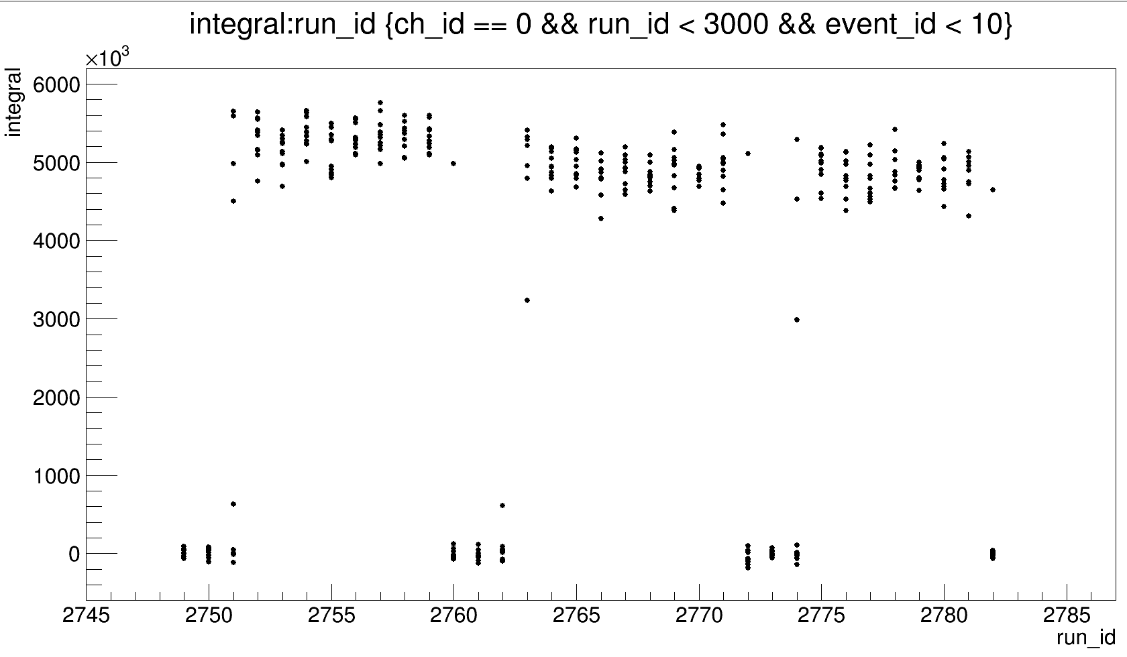
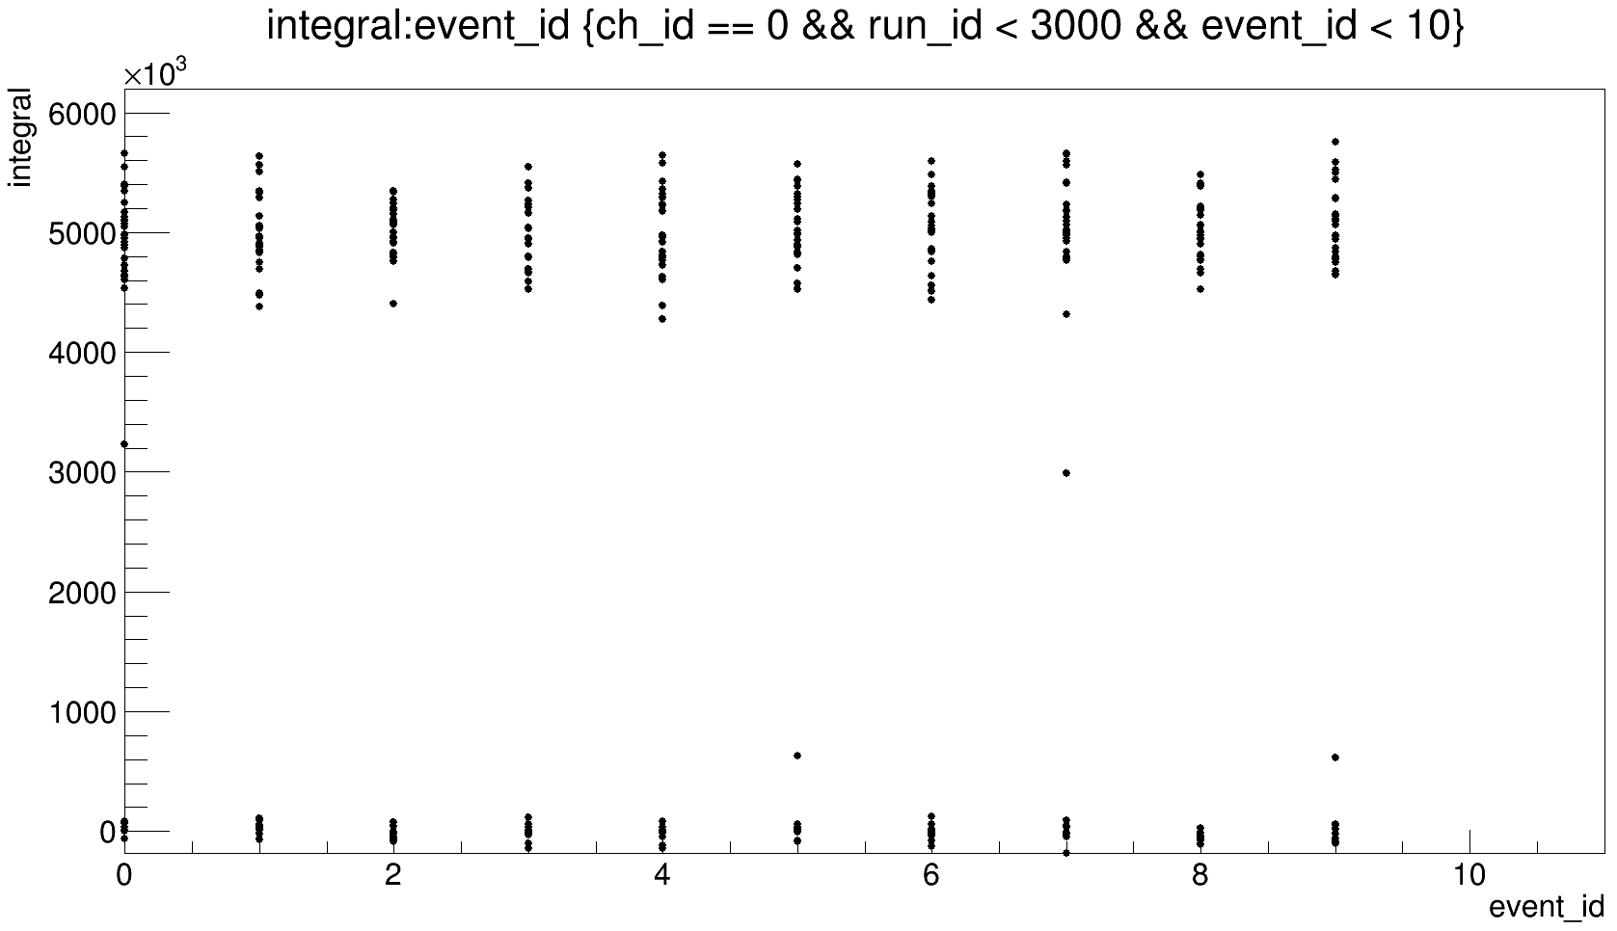
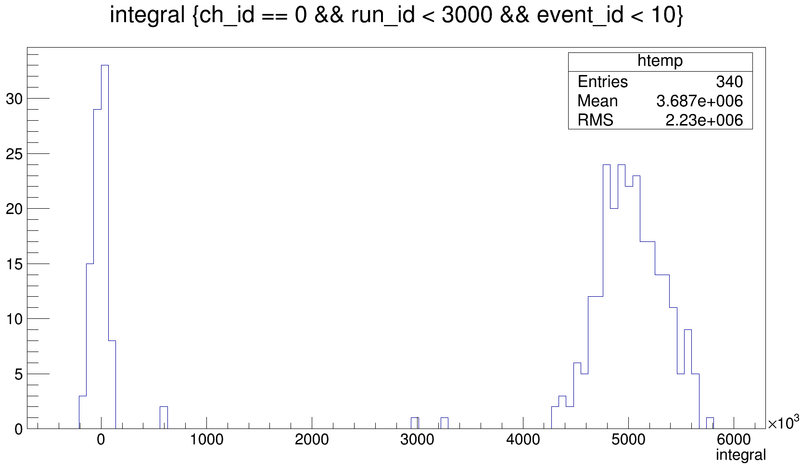
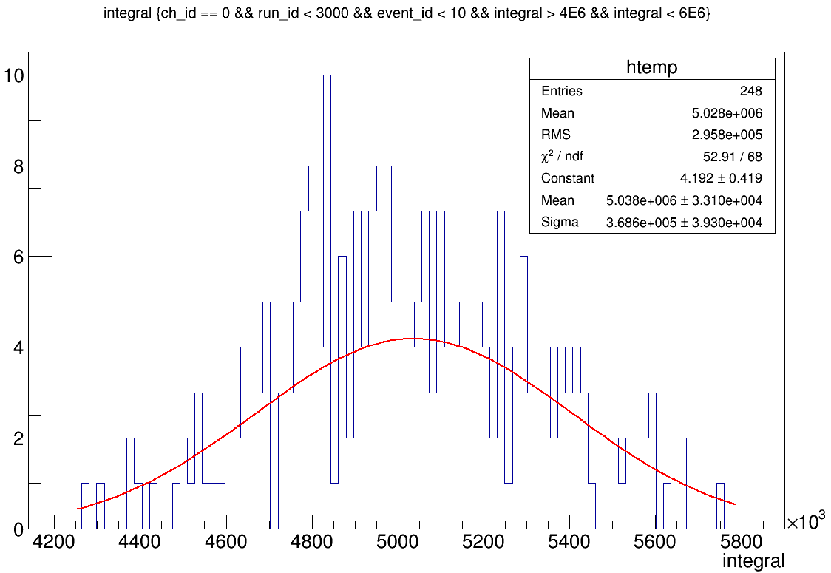
event_x-ray_20_thmV, ∑3PMT
Отключали пушку
From 35000 to 69500 ns

Slide 6
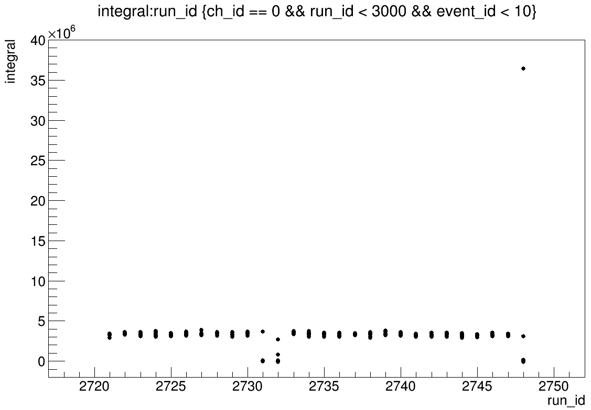
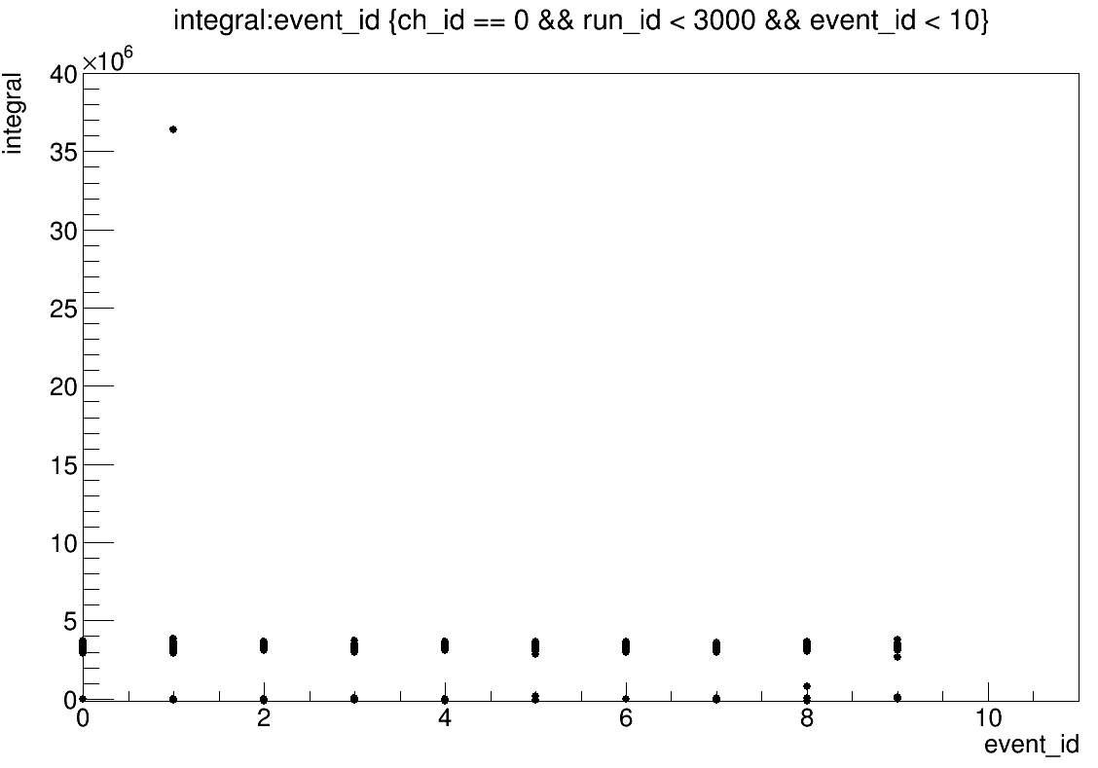
event_x-ray_18_small_2 , ∑3PMT
Тут все равномерно
From 35000 to 69500 ns

Slide 7
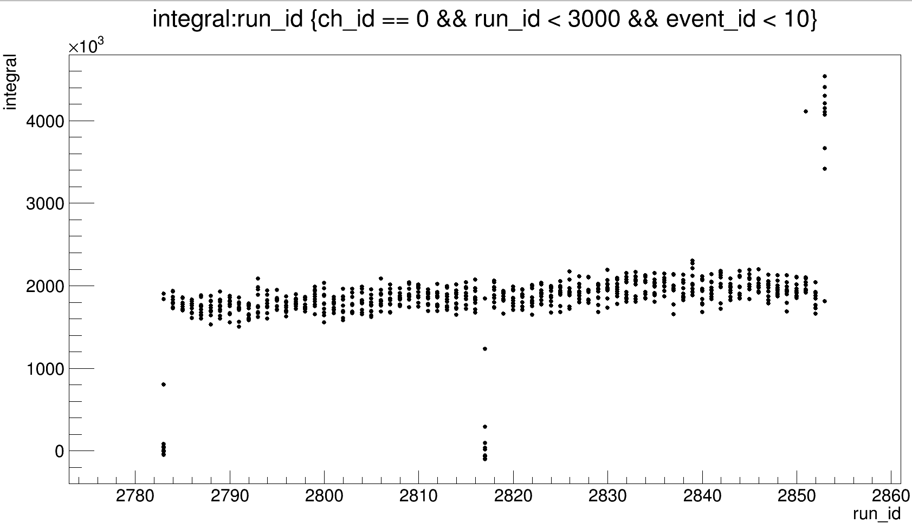
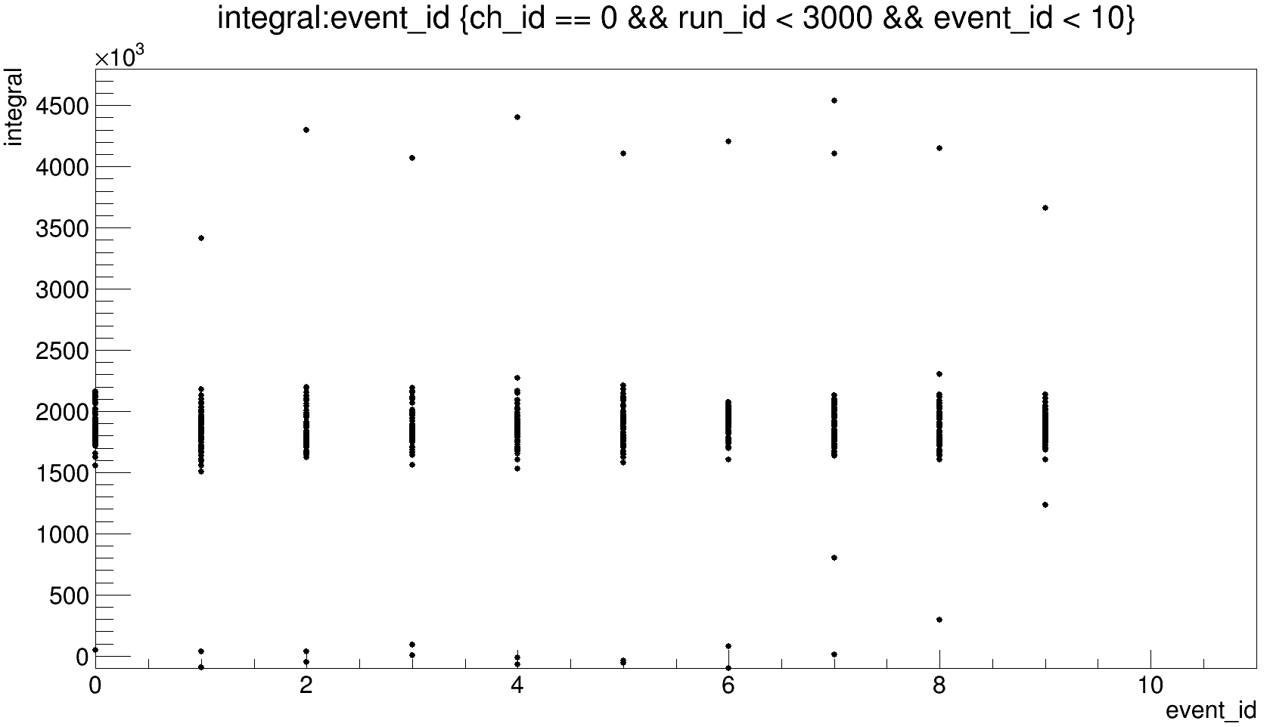
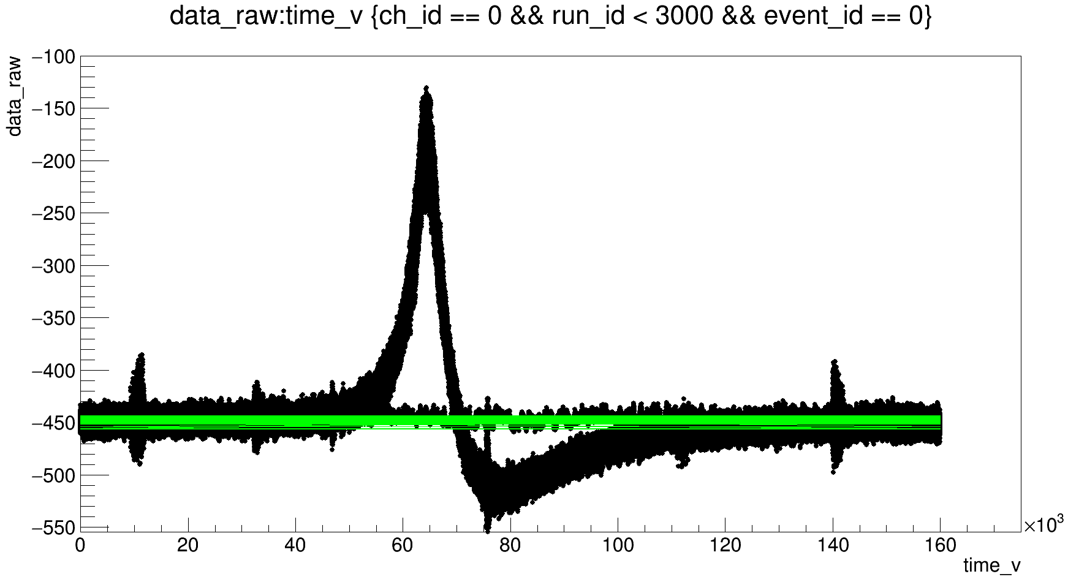
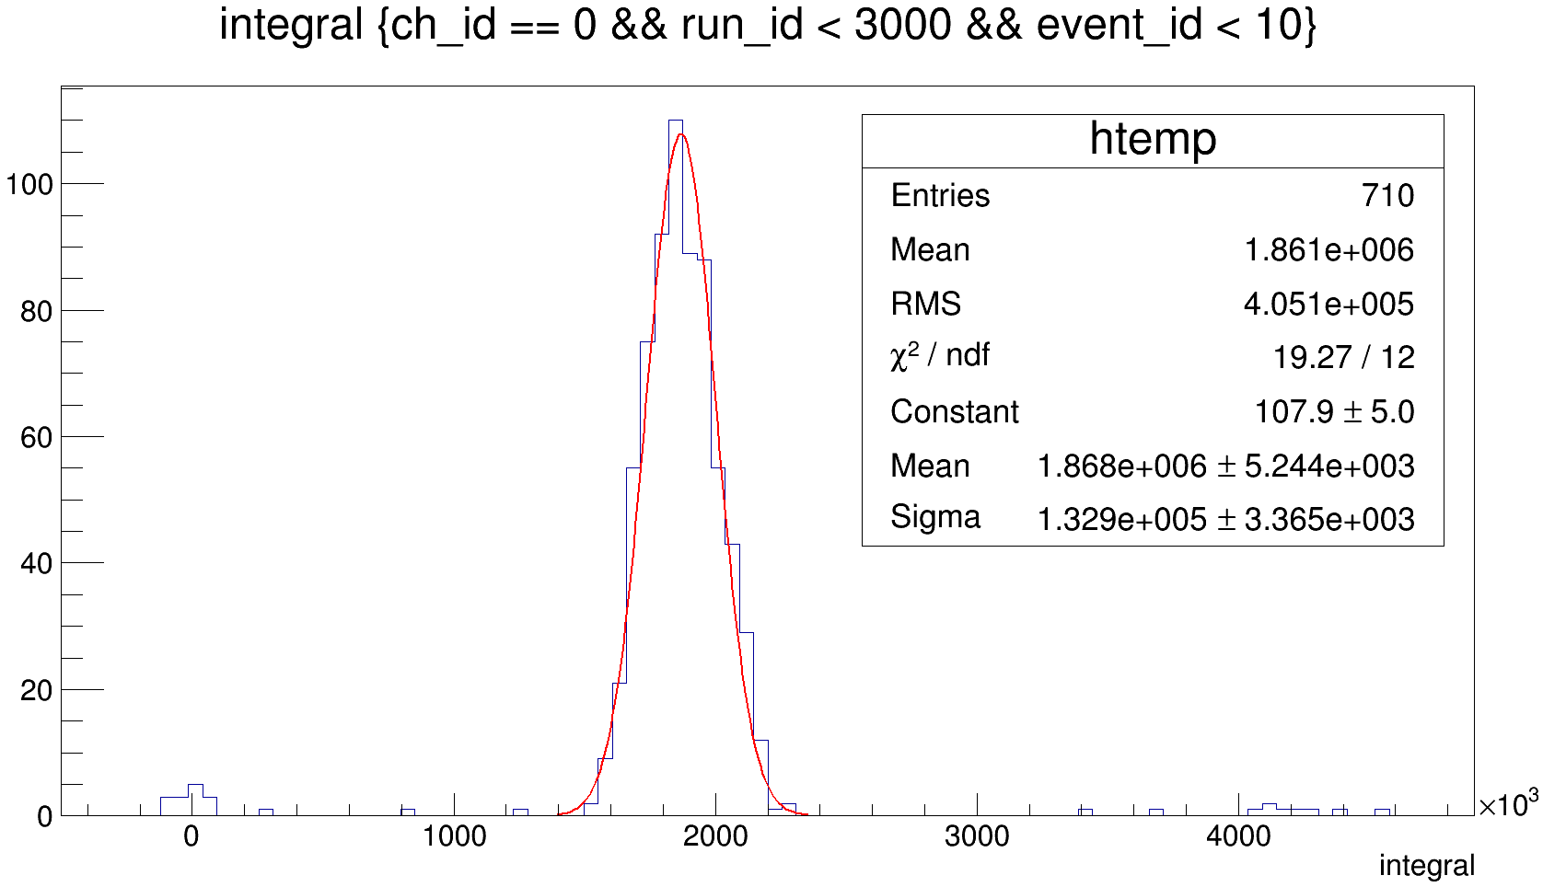
event_x-ray_16_thmV , ∑3PMT
From 35000 to 70500 ns
71 graphs

Slide 8
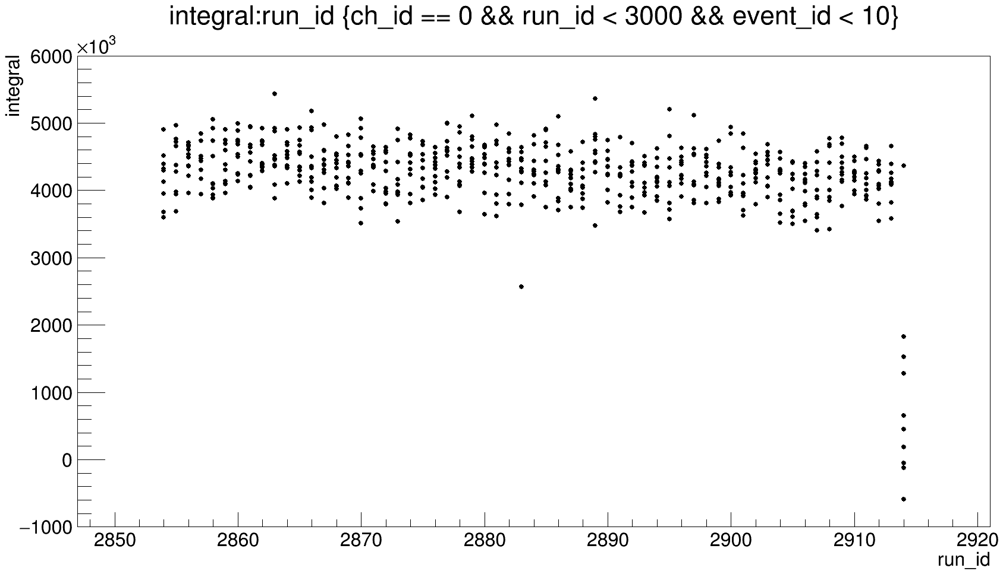
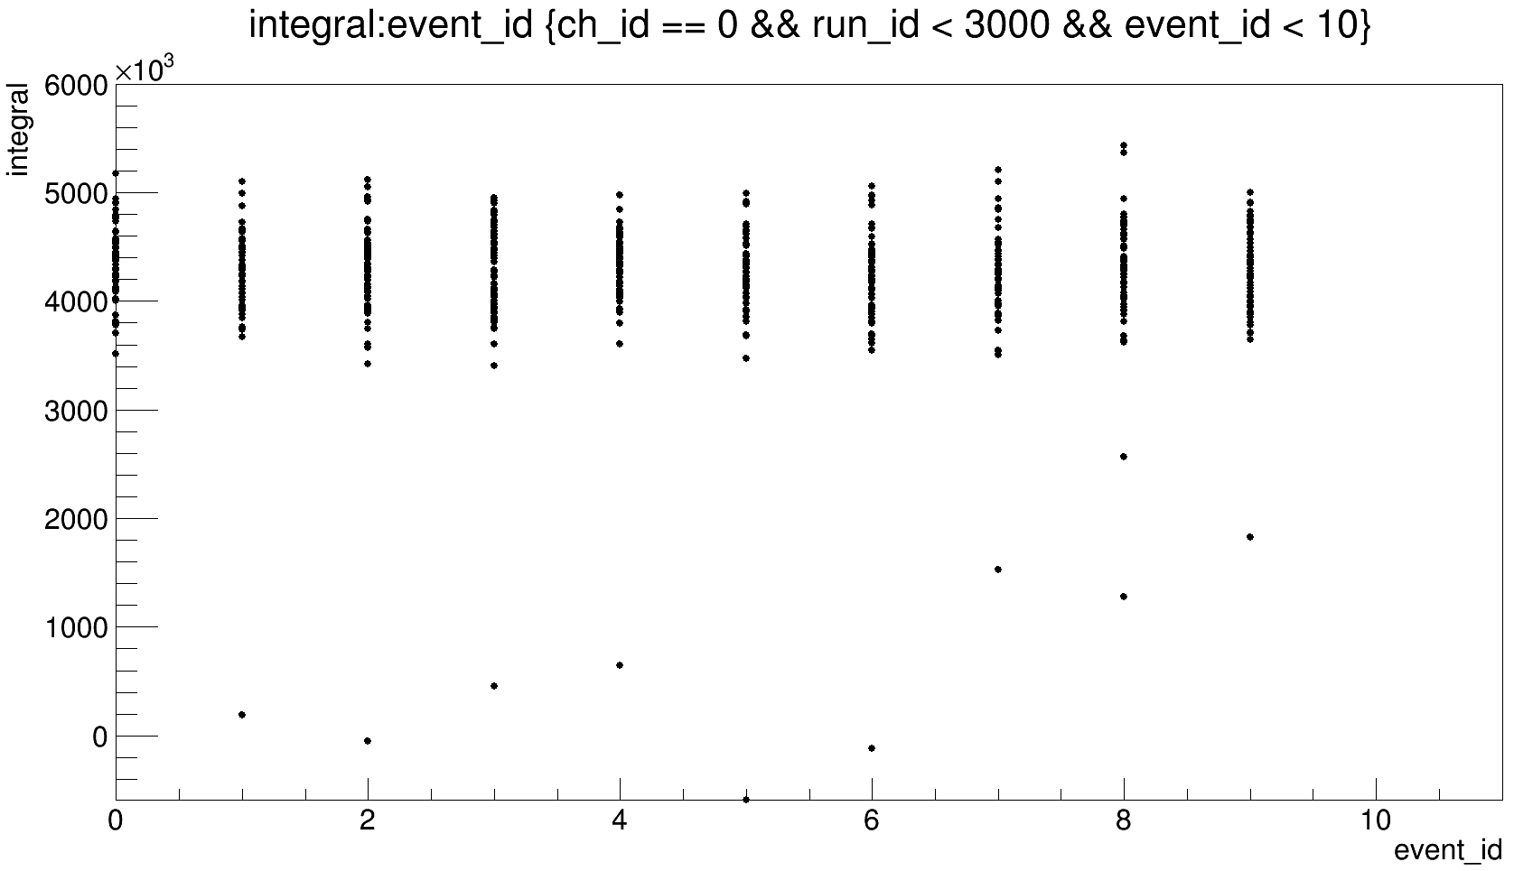
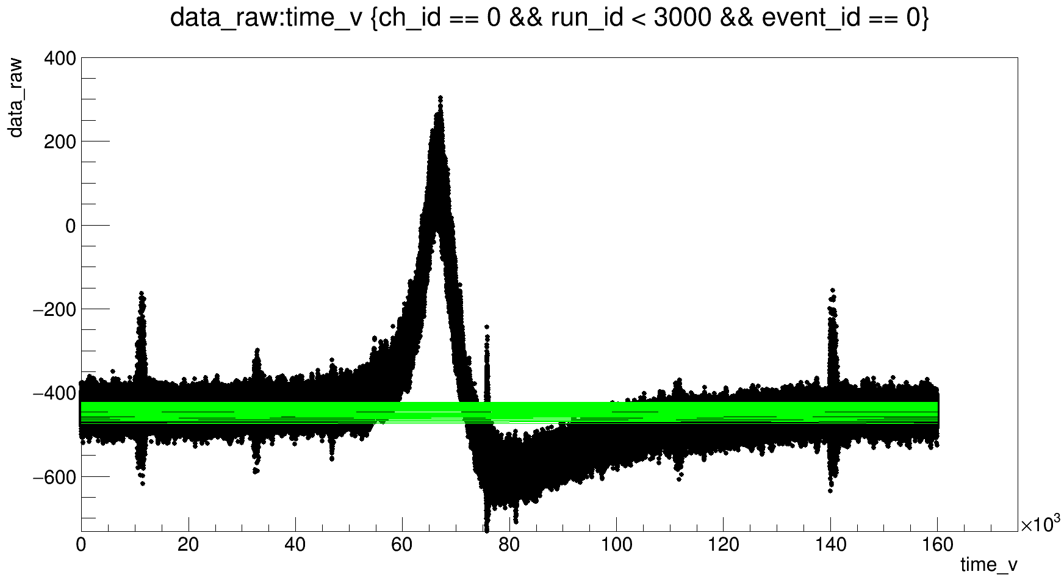
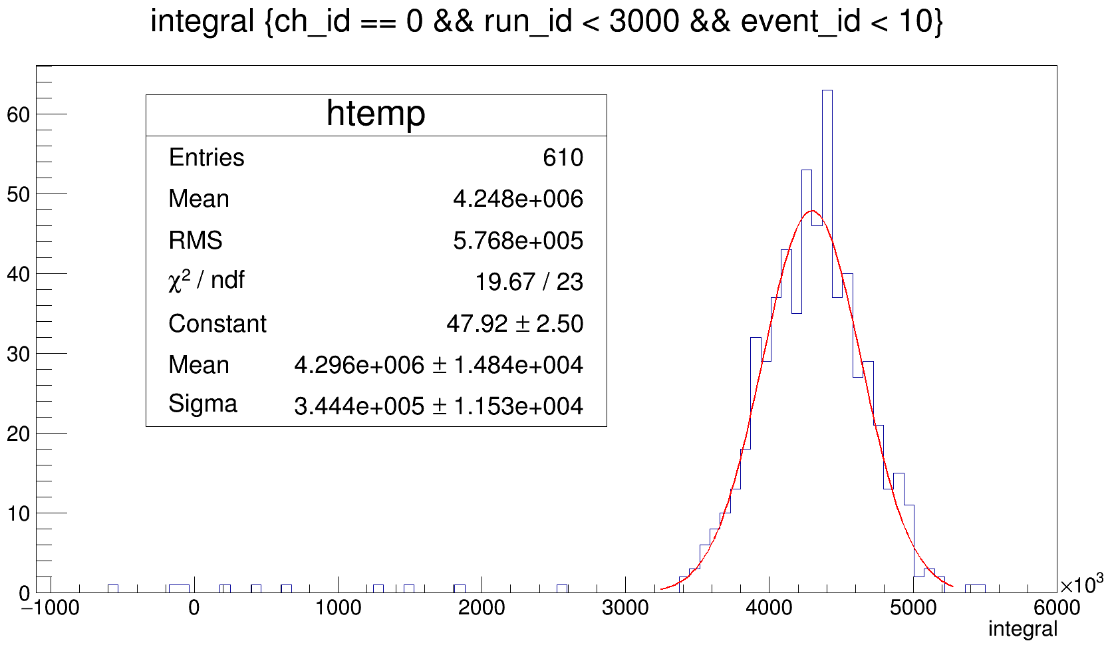
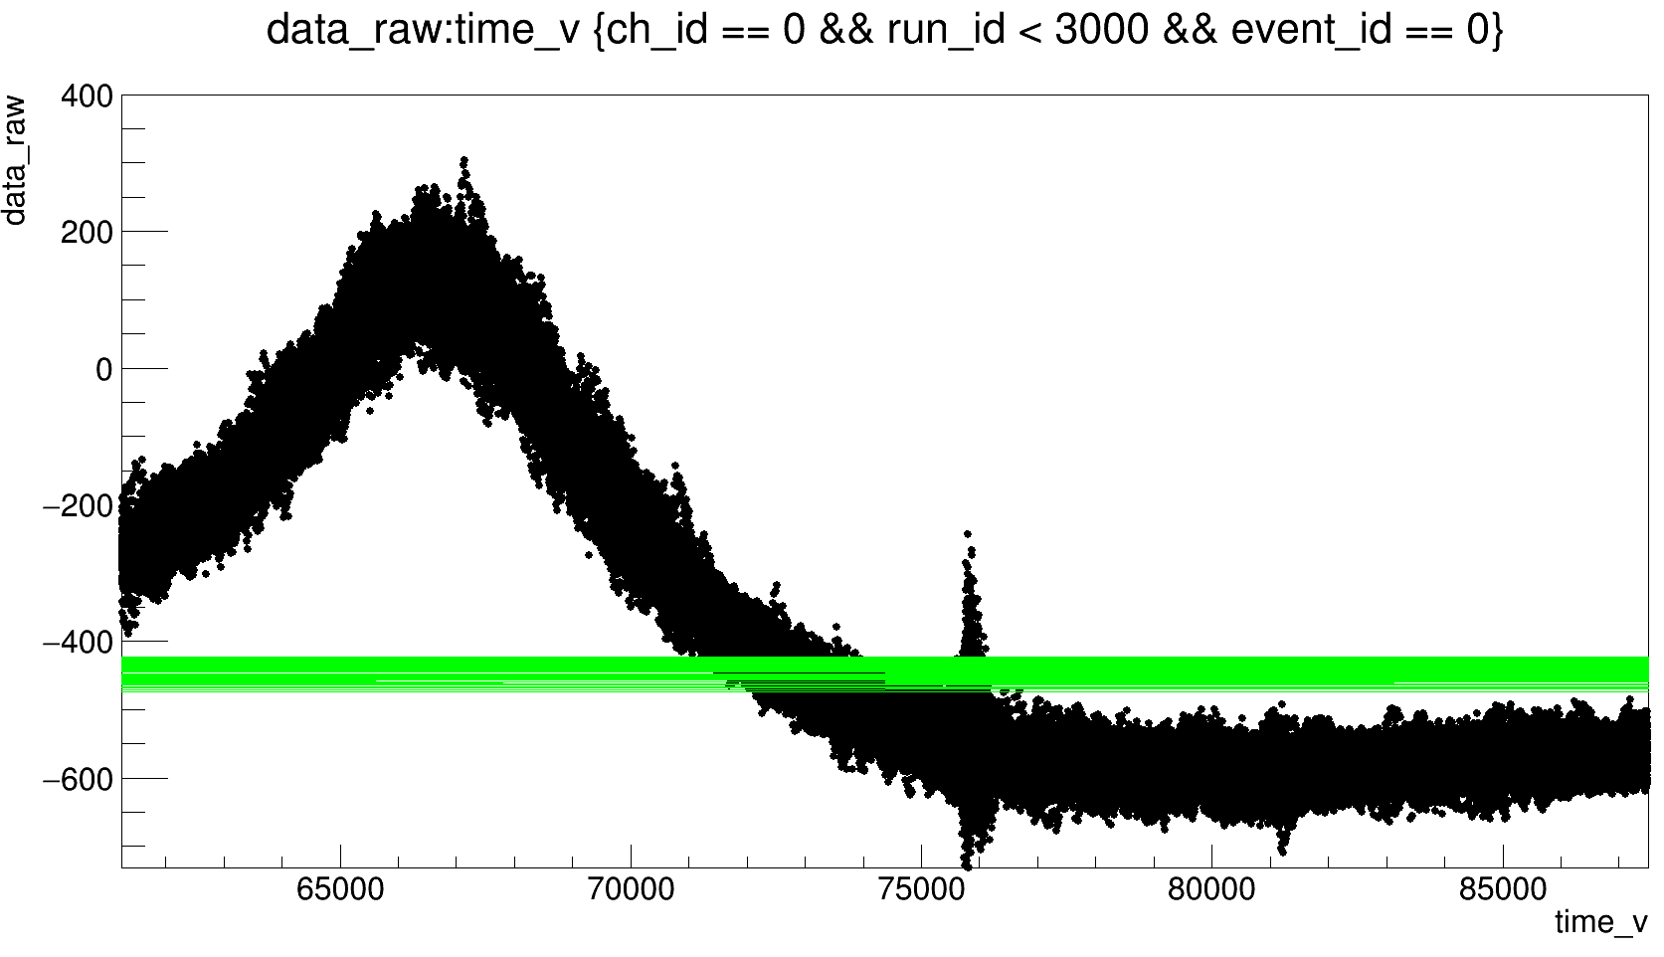
event_x-ray_14_thmV , ∑3PMT
61 graphs
From 35000 to 73000 ns

Slide 9
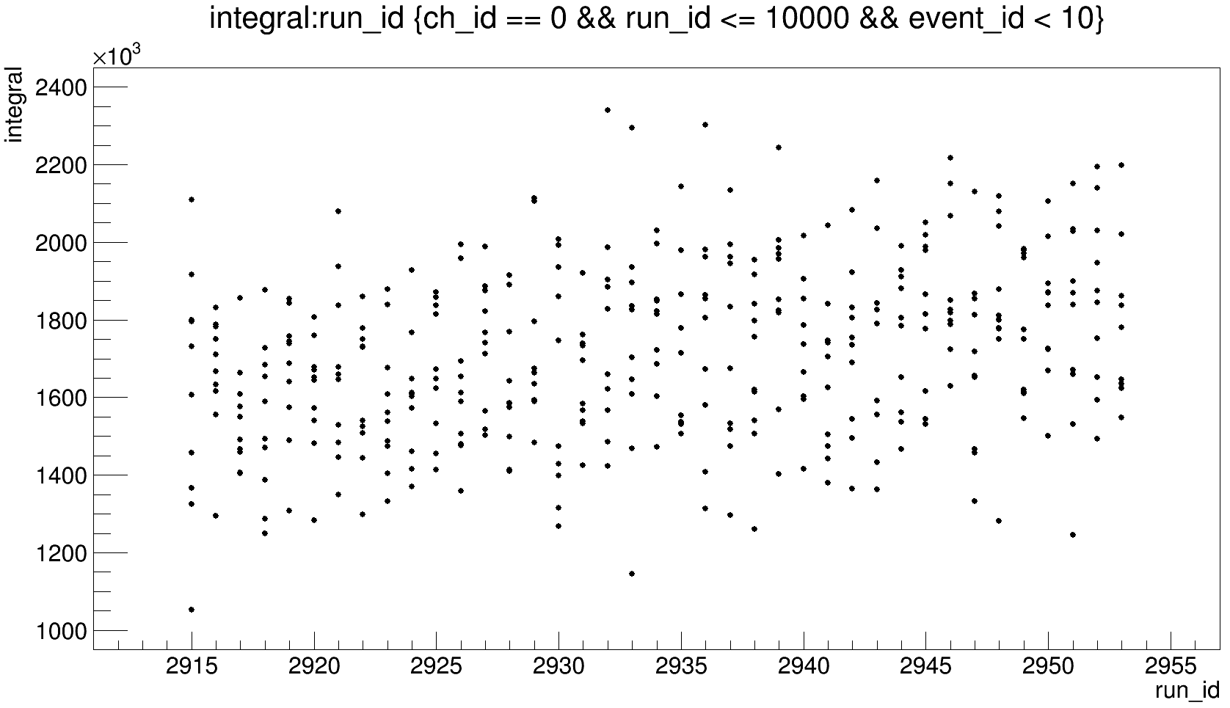
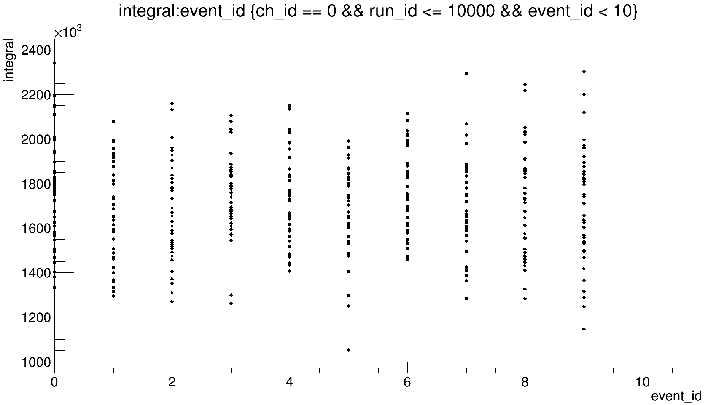
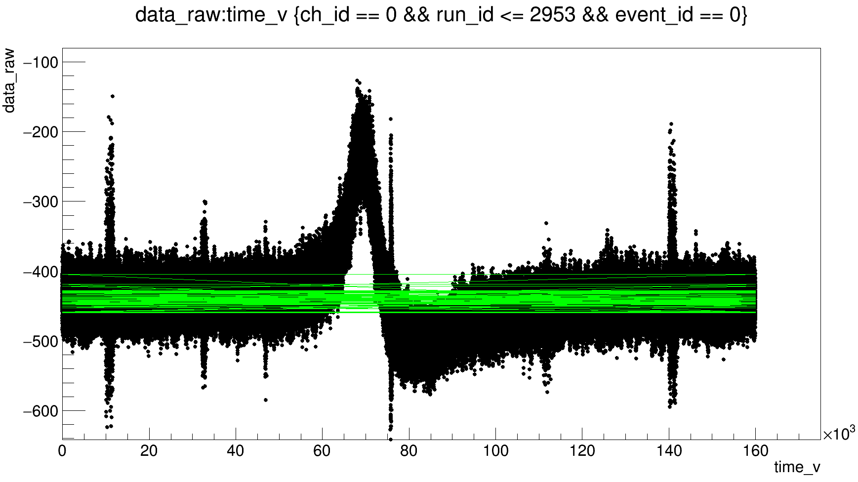
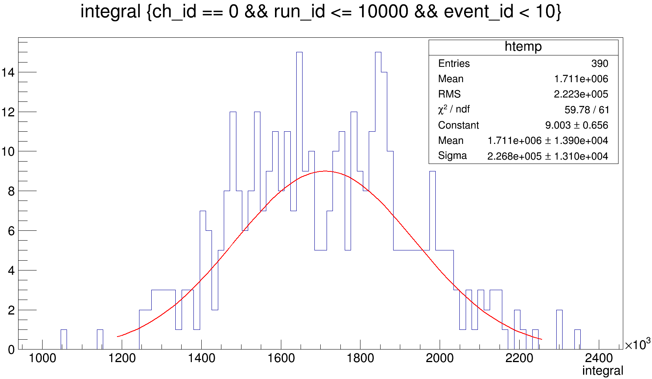
event_x-ray_12_thmV , ∑3PMT
From 50000 to 74500 ns

Slide 10
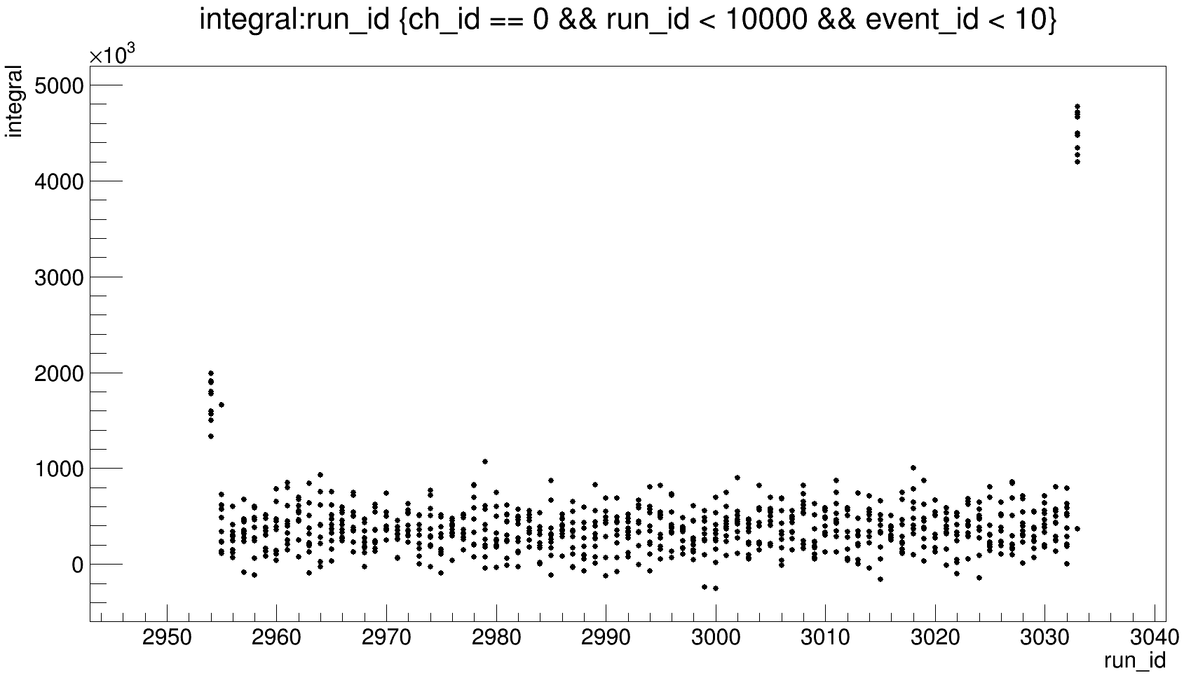
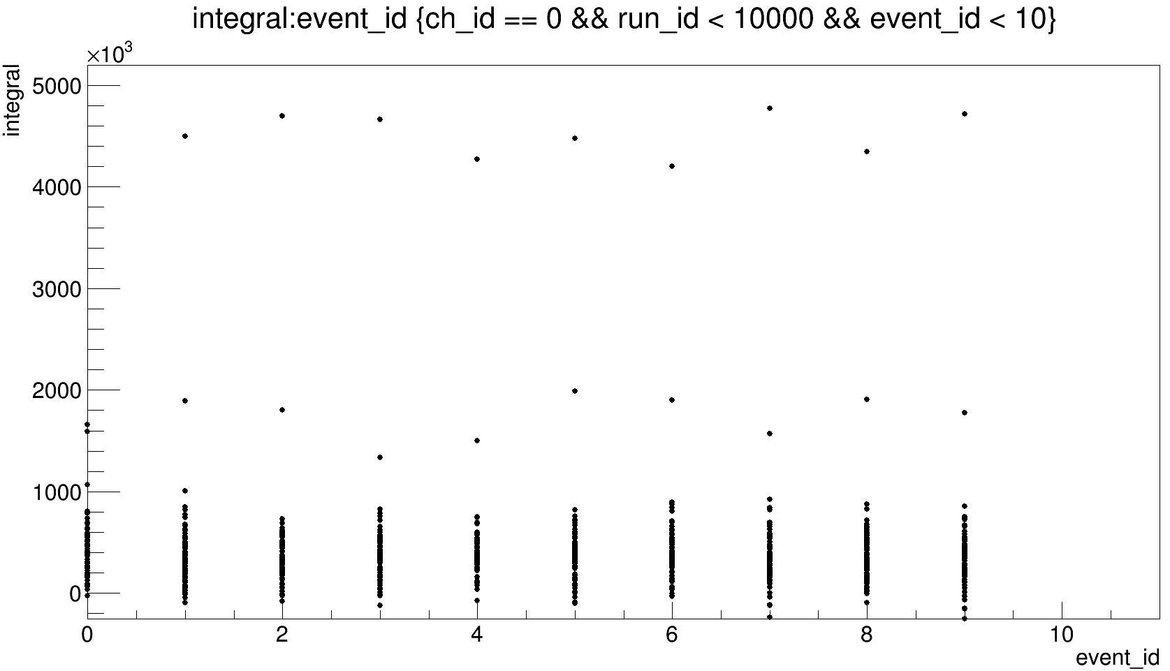
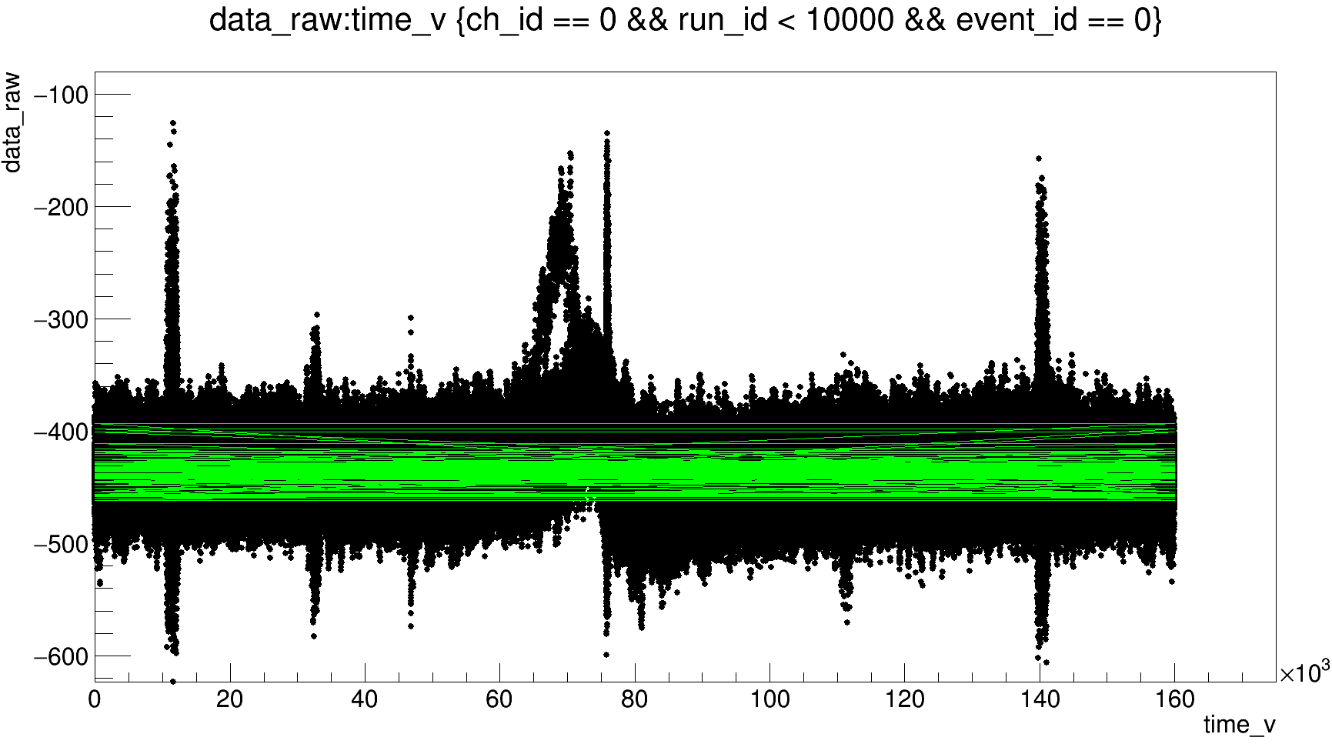
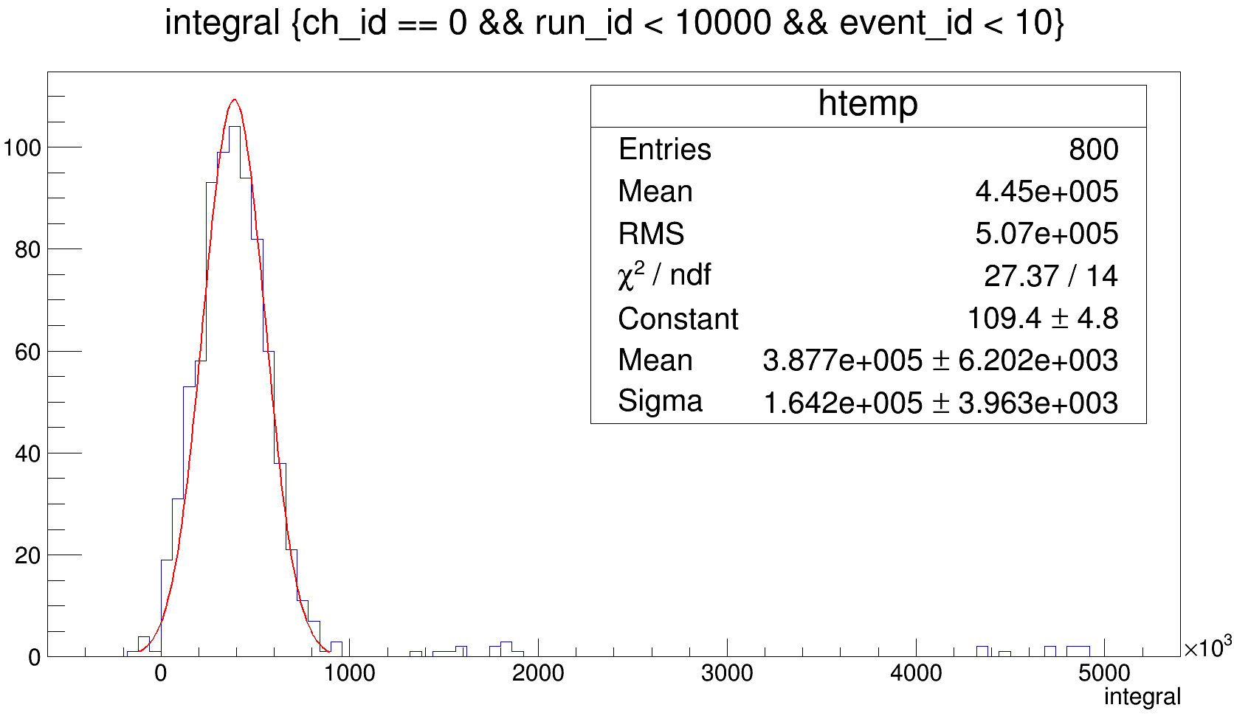
event_x-ray_10_thmV , ∑3PMT
From 55000 to 75000 ns

Slide 11
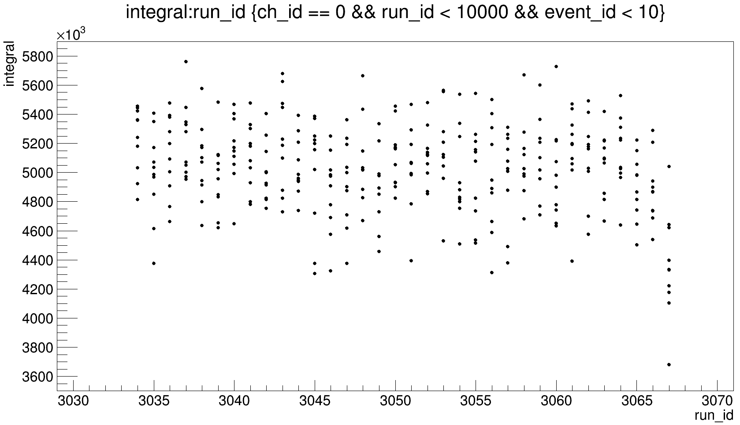
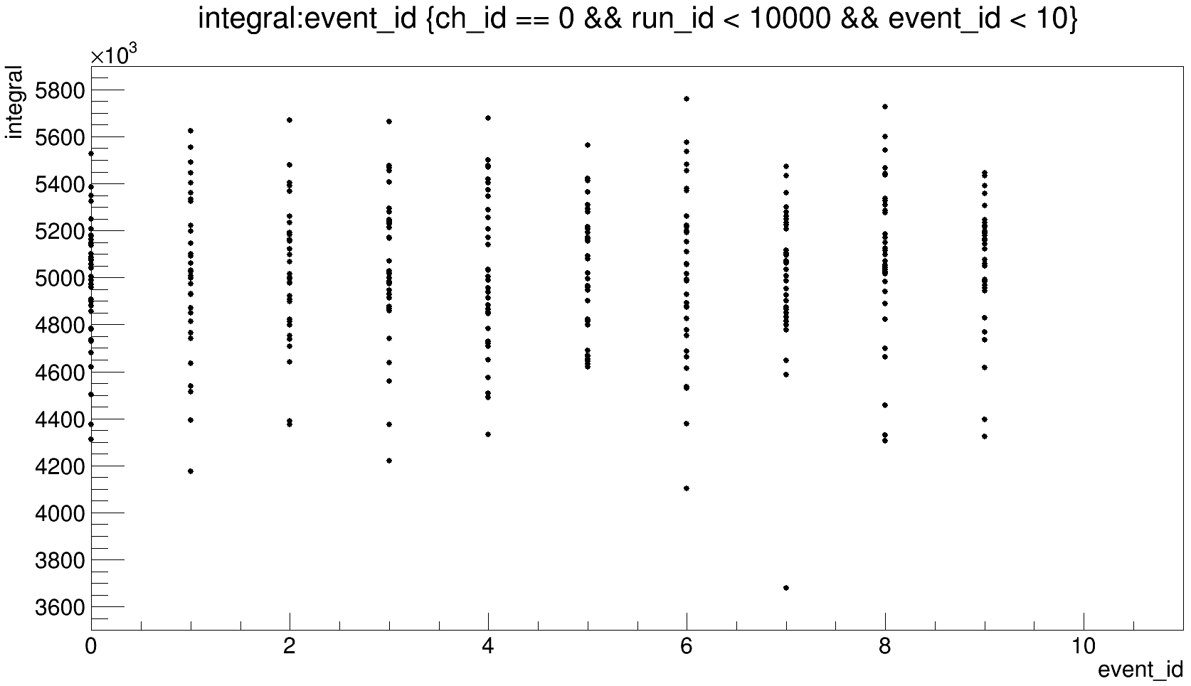
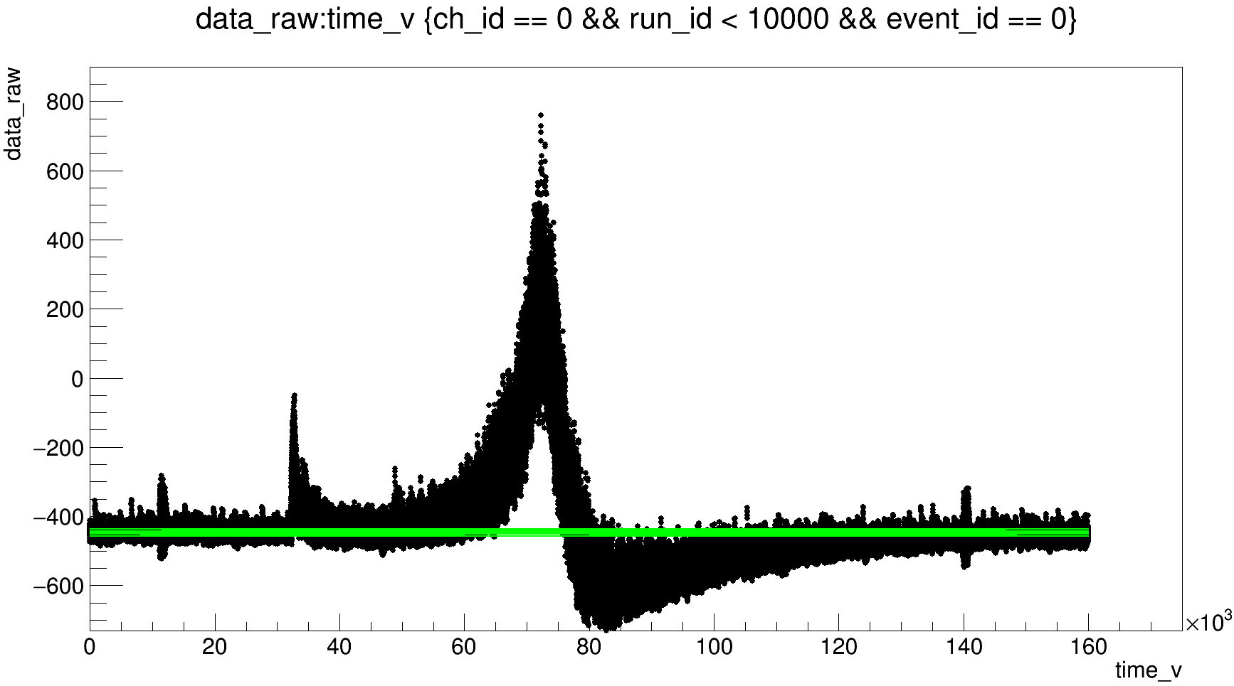
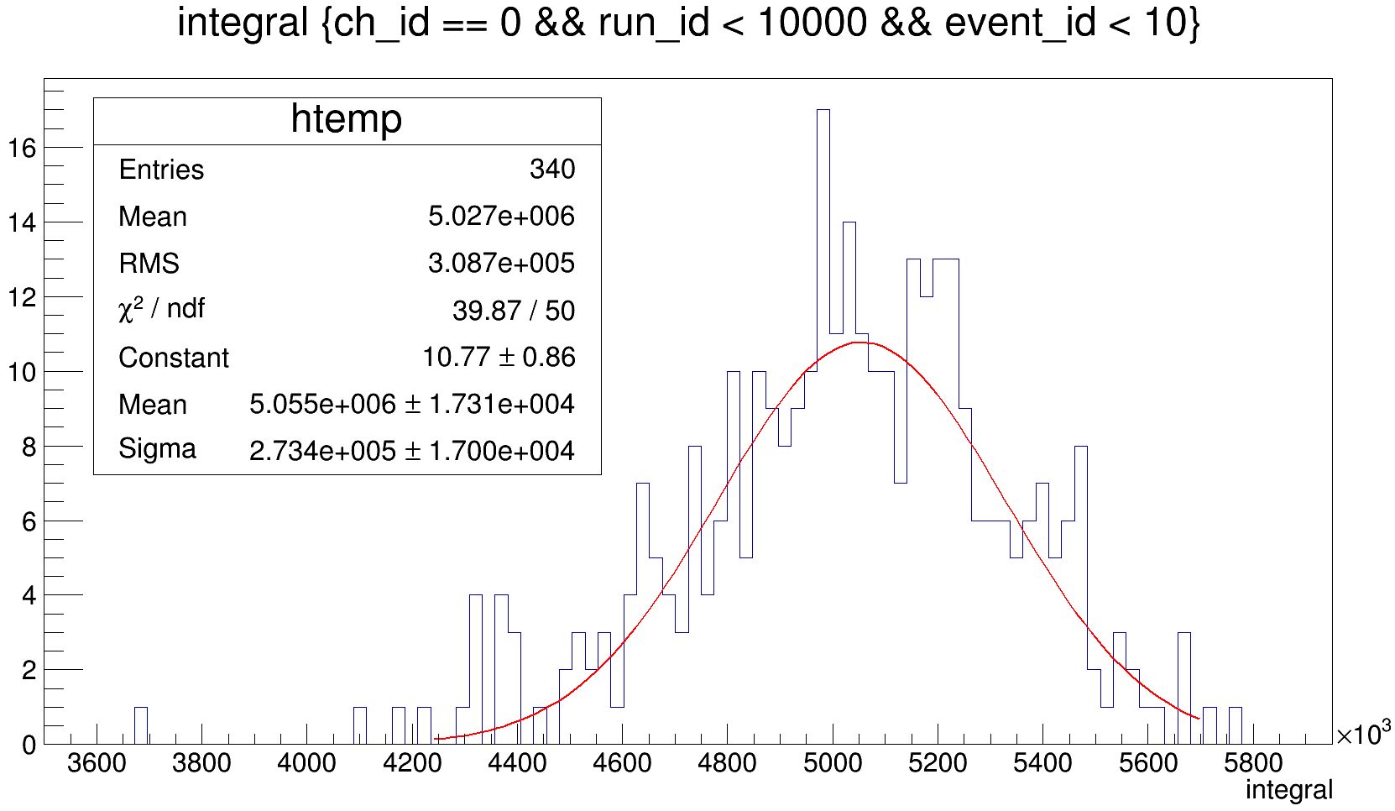
event_x-ray_10_thmV_recalib , ∑3PMT
From 55000 to 78000 ns

Slide 12
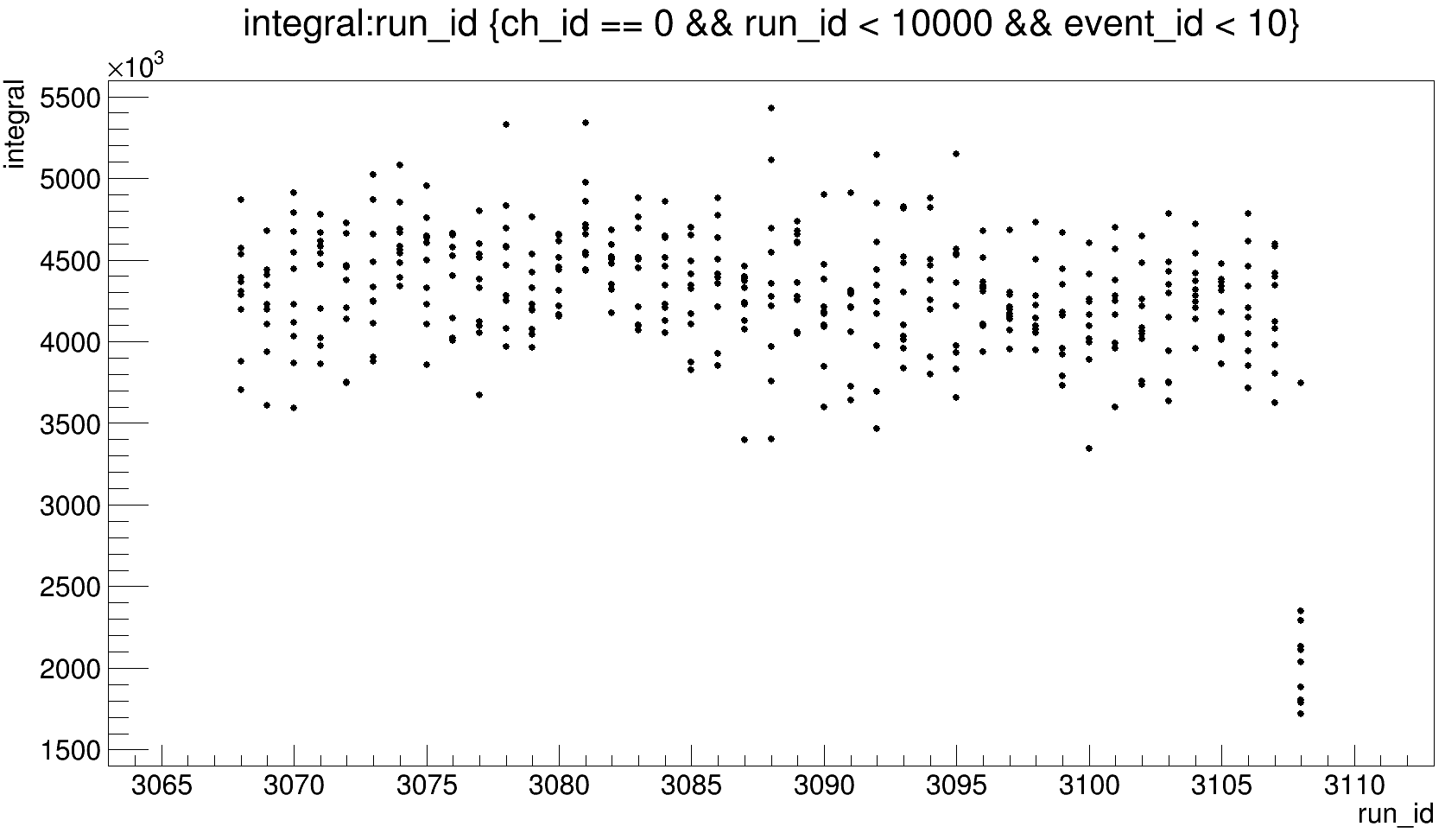
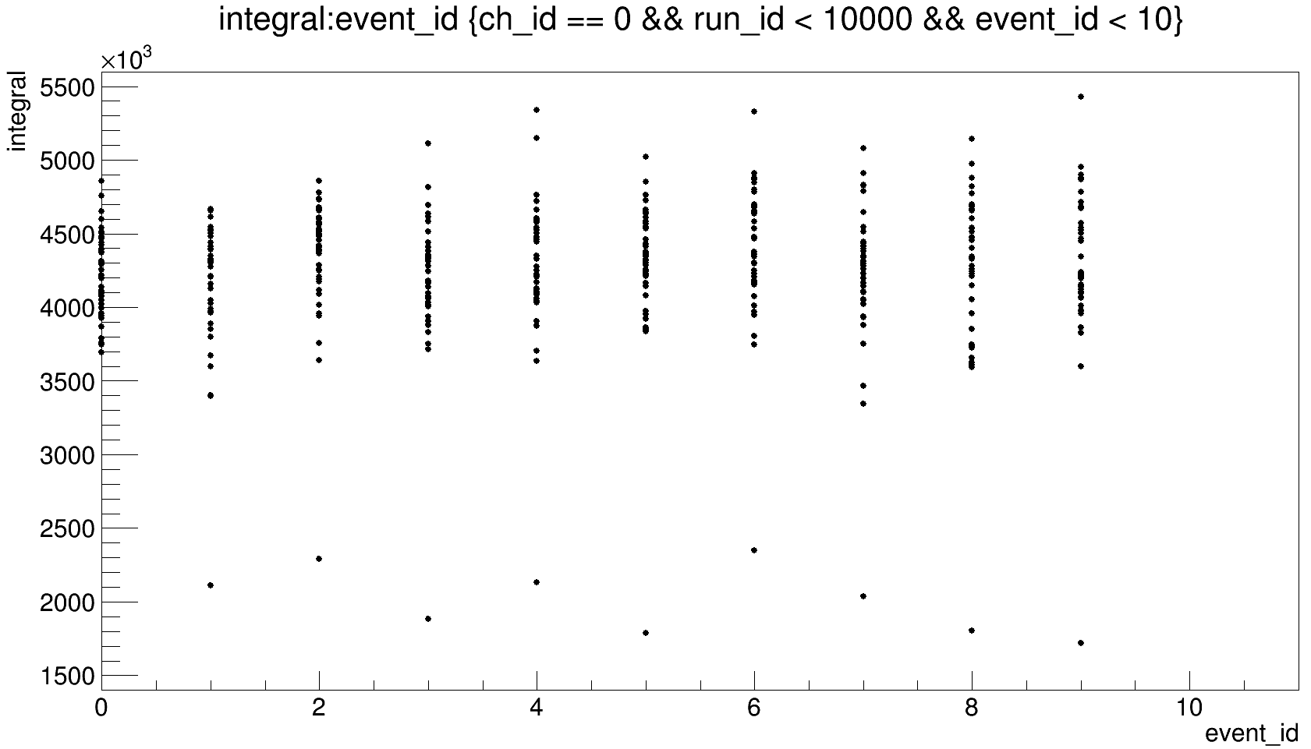
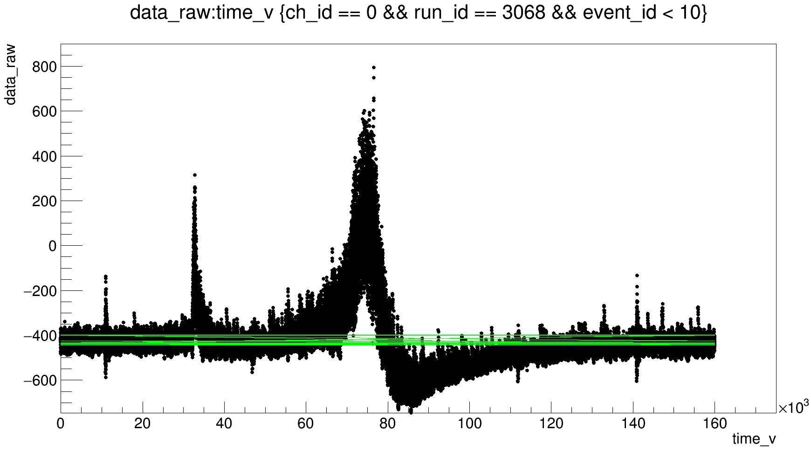
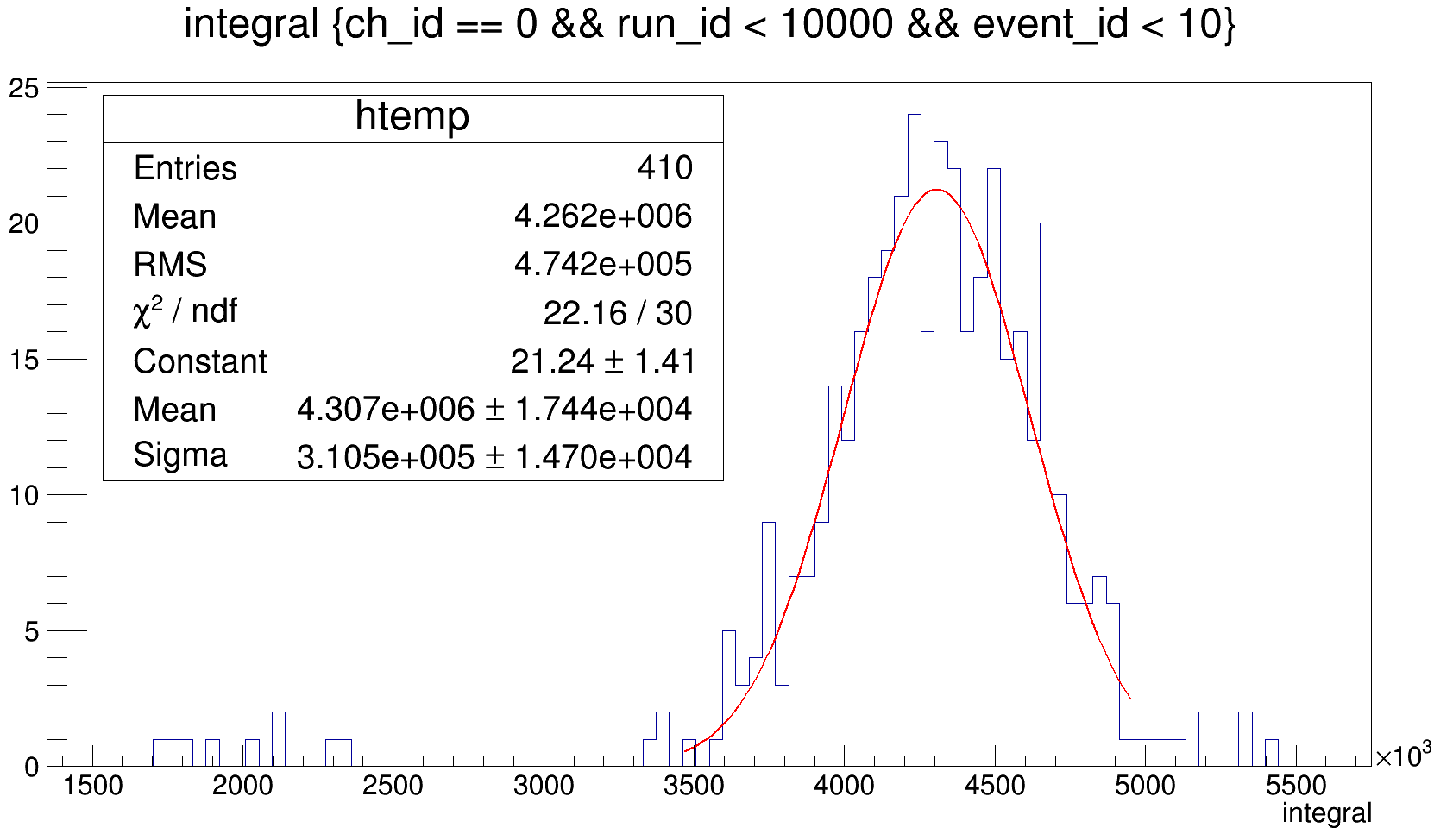
event_x-ray_9_thmV, ∑3PMT
From 60000 to 79500 ns

Slide 13
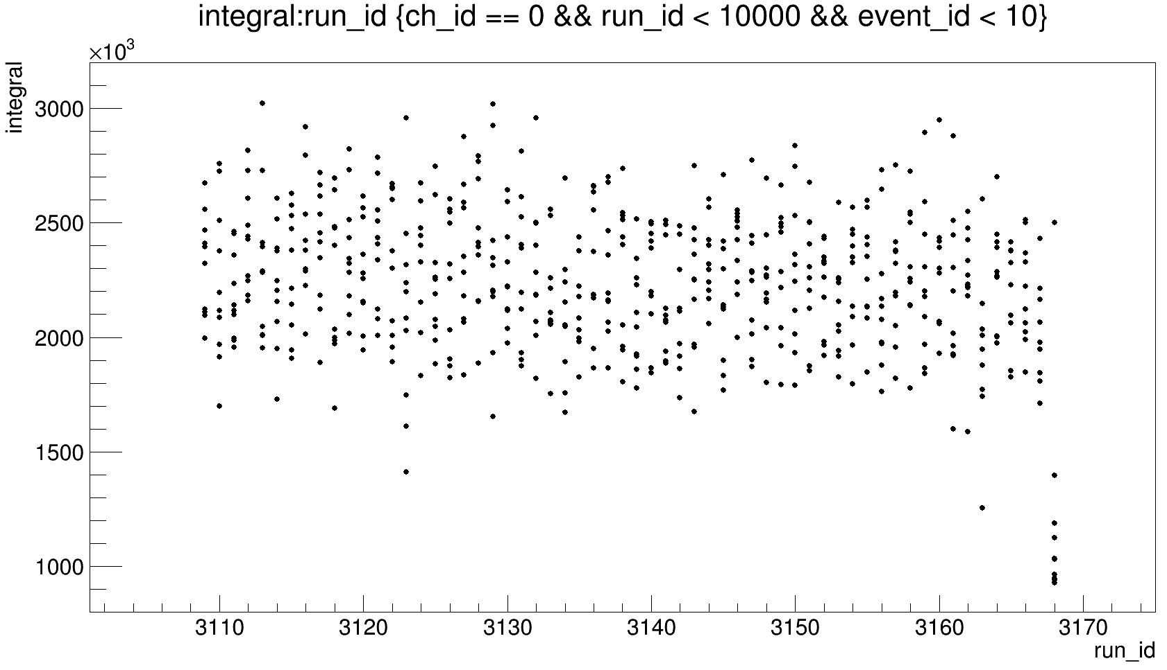
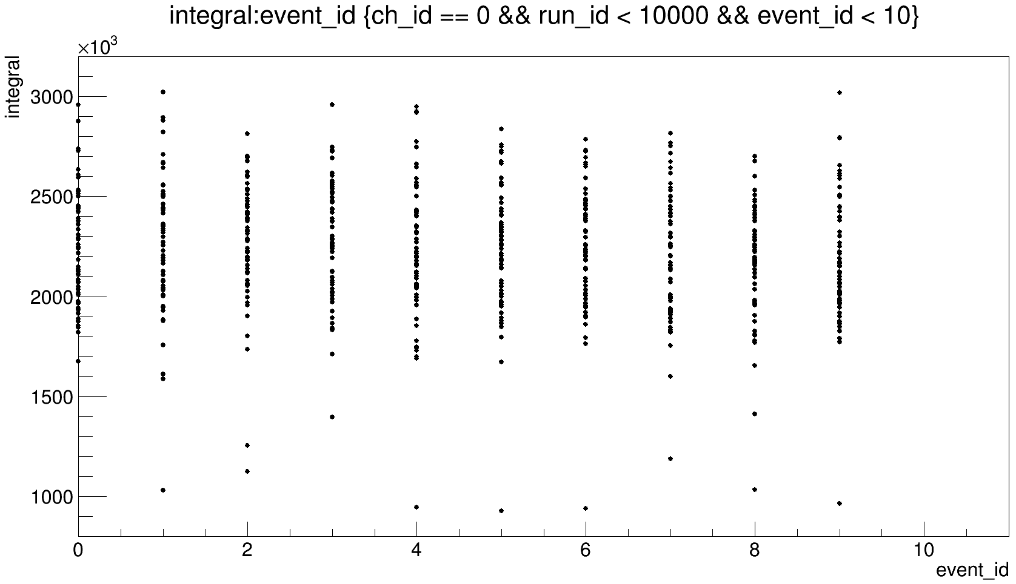
event_x-ray_8_thmV, ∑3PMT

Slide 14
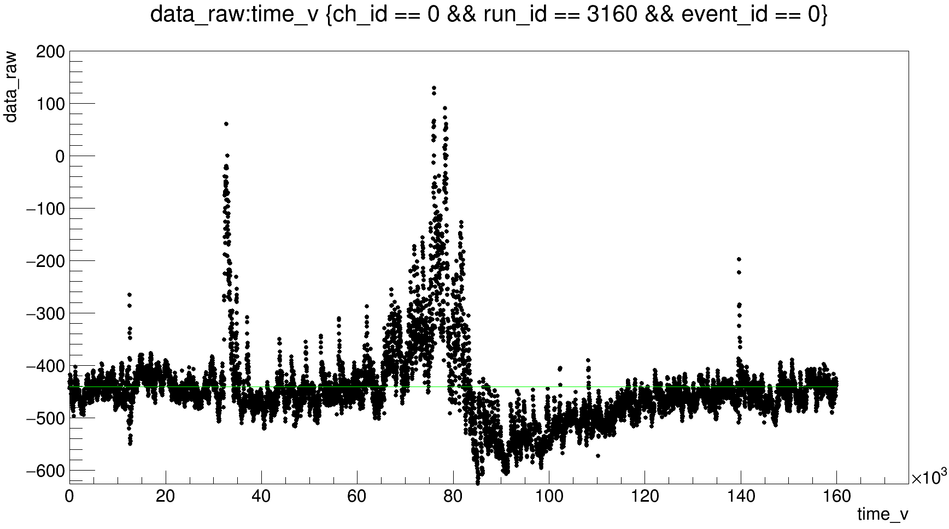
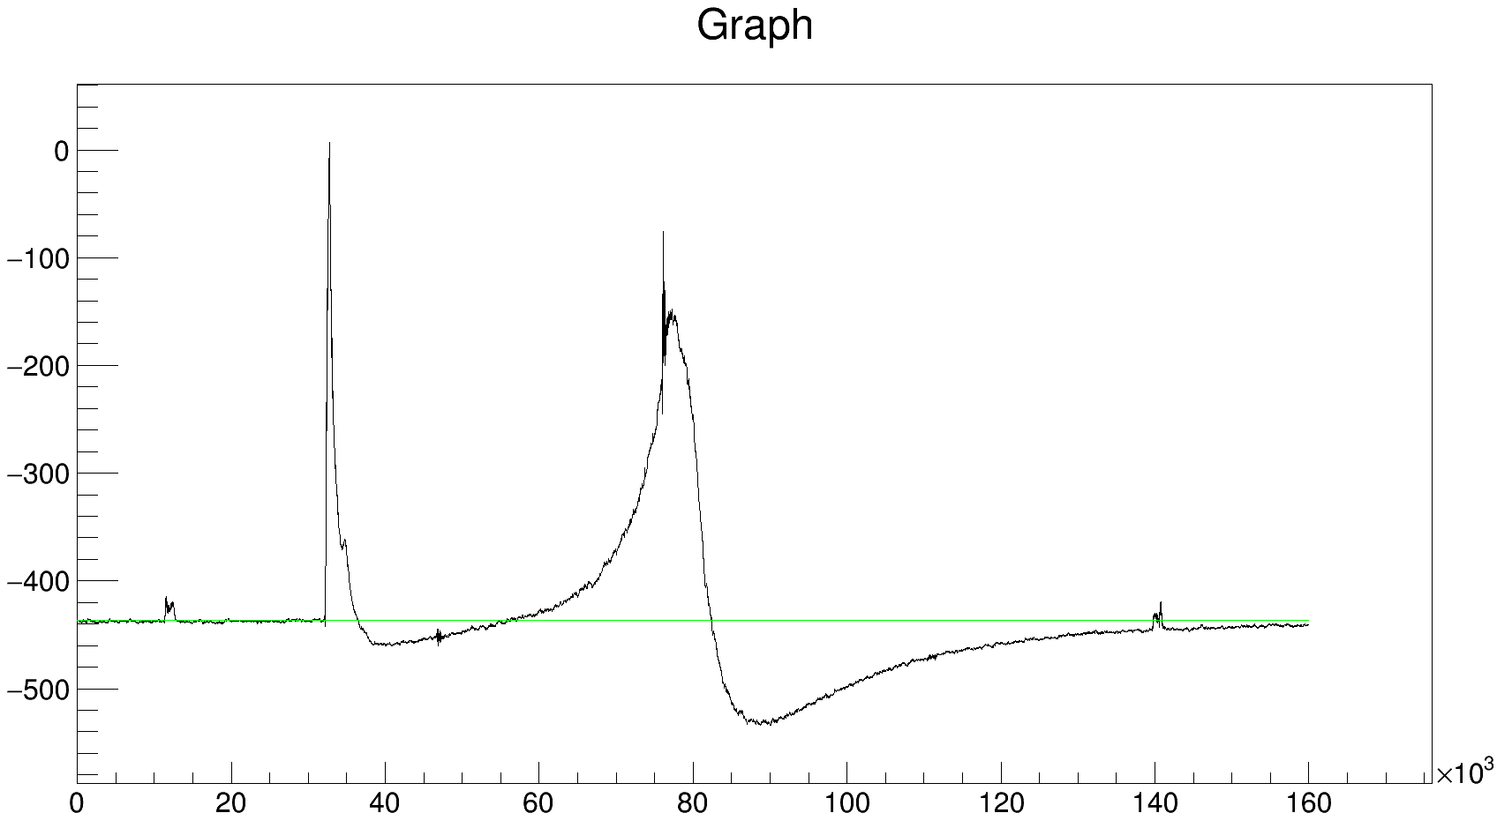
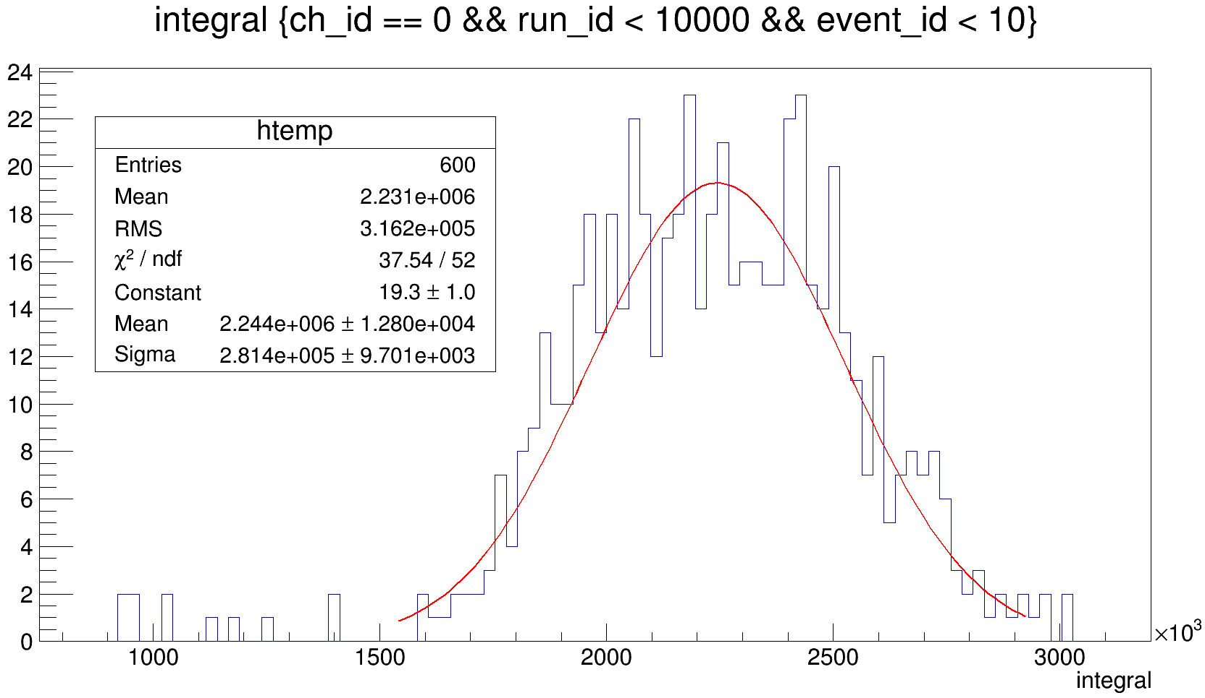
event_x-ray_8_thmV, ∑3PMT
From 56000 to 82300 ns
510 averaged graphs

Slide 15
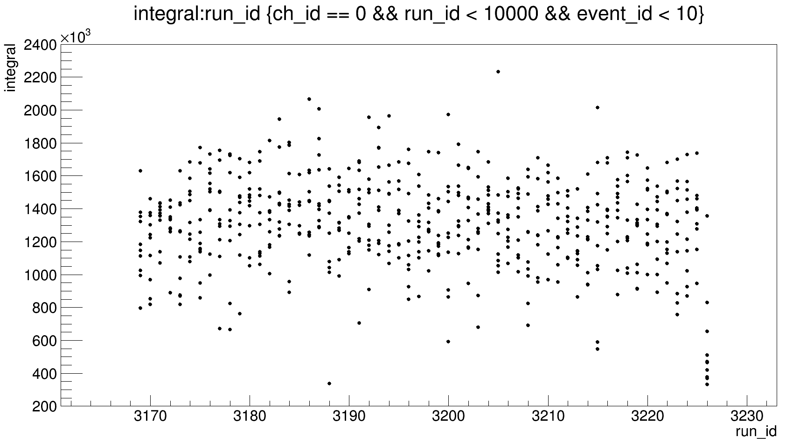
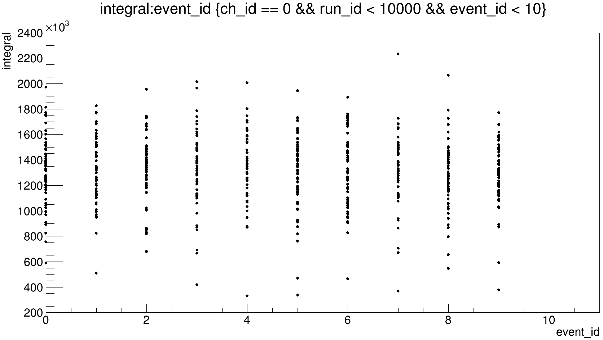
event_x-ray_7_thmV, ∑3PMT

Slide 16
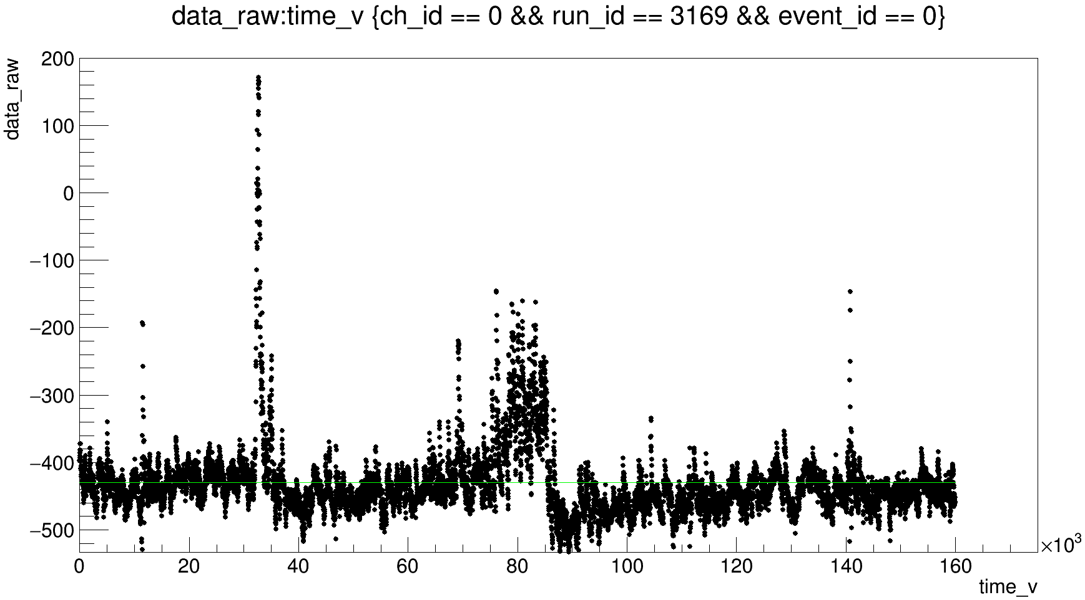
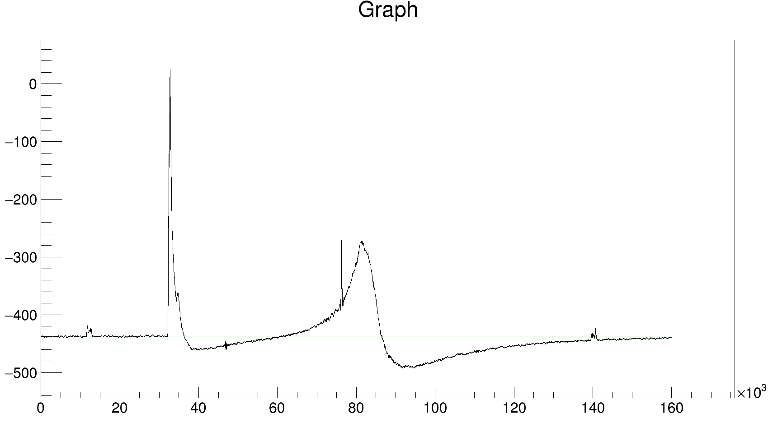
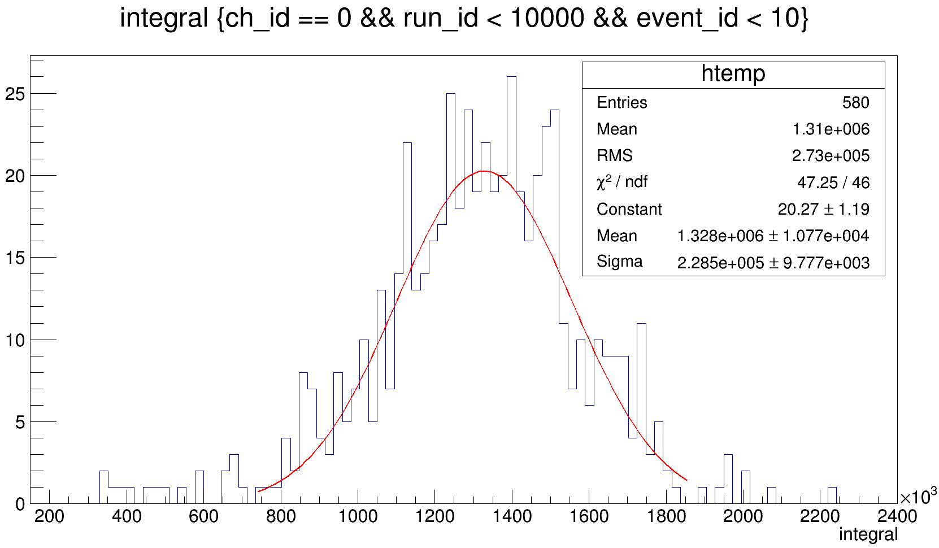
event_x-ray_7_thmV, ∑3PMT
From 62000 to 86500 ns

Slide 17
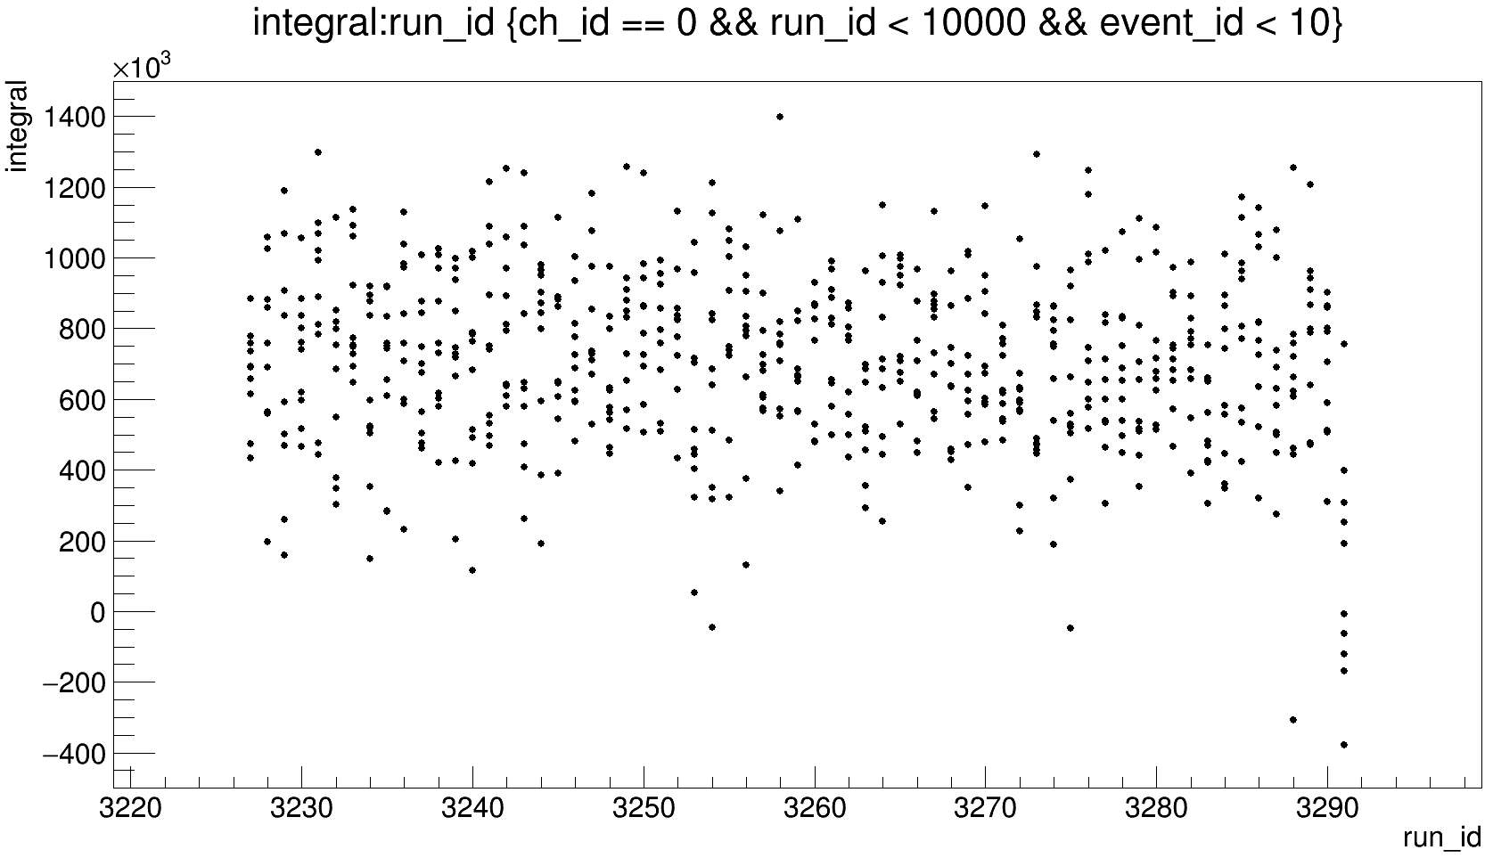
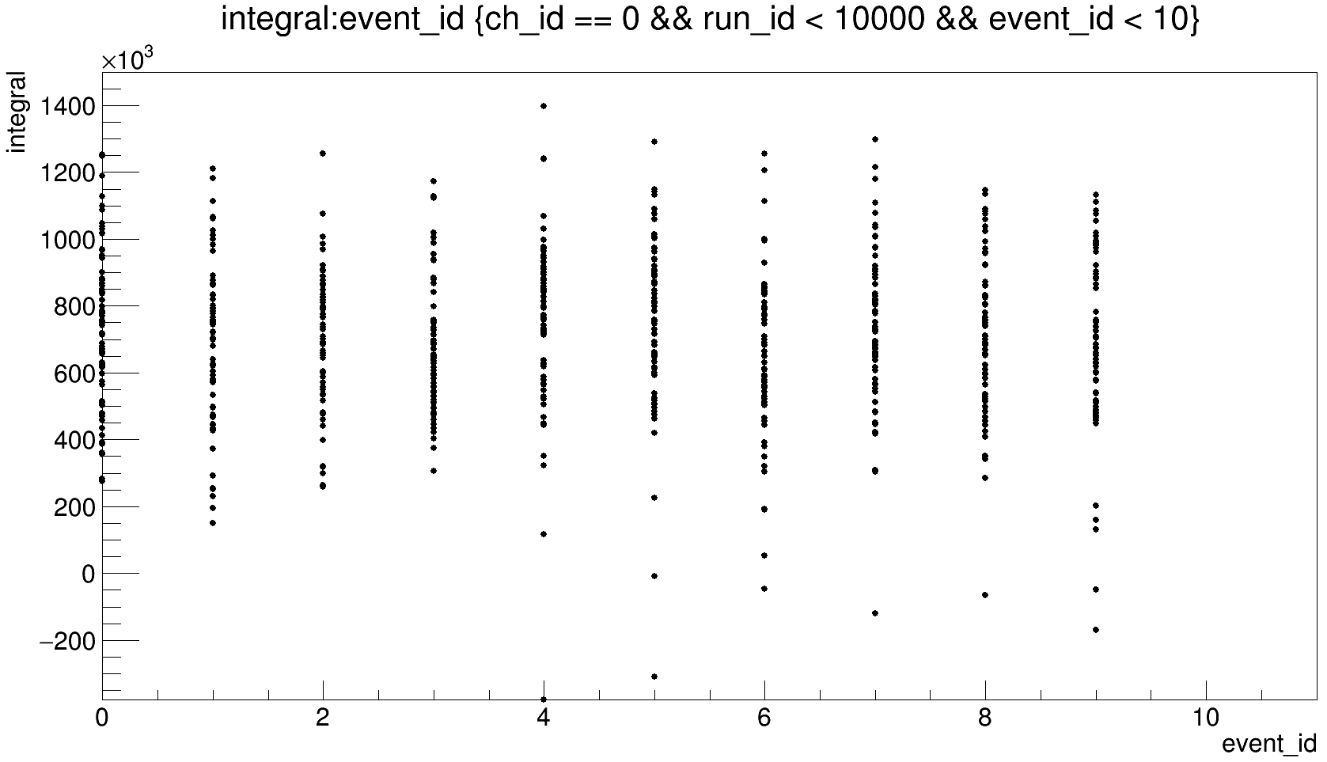
event_x-ray_6_thmV, ∑3PMT

Slide 18
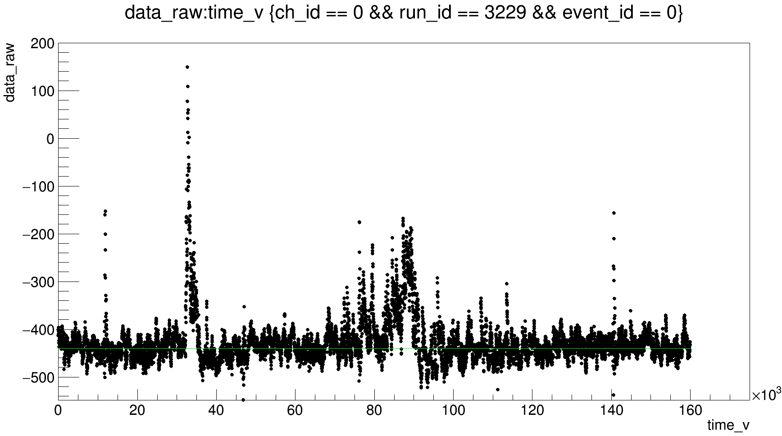
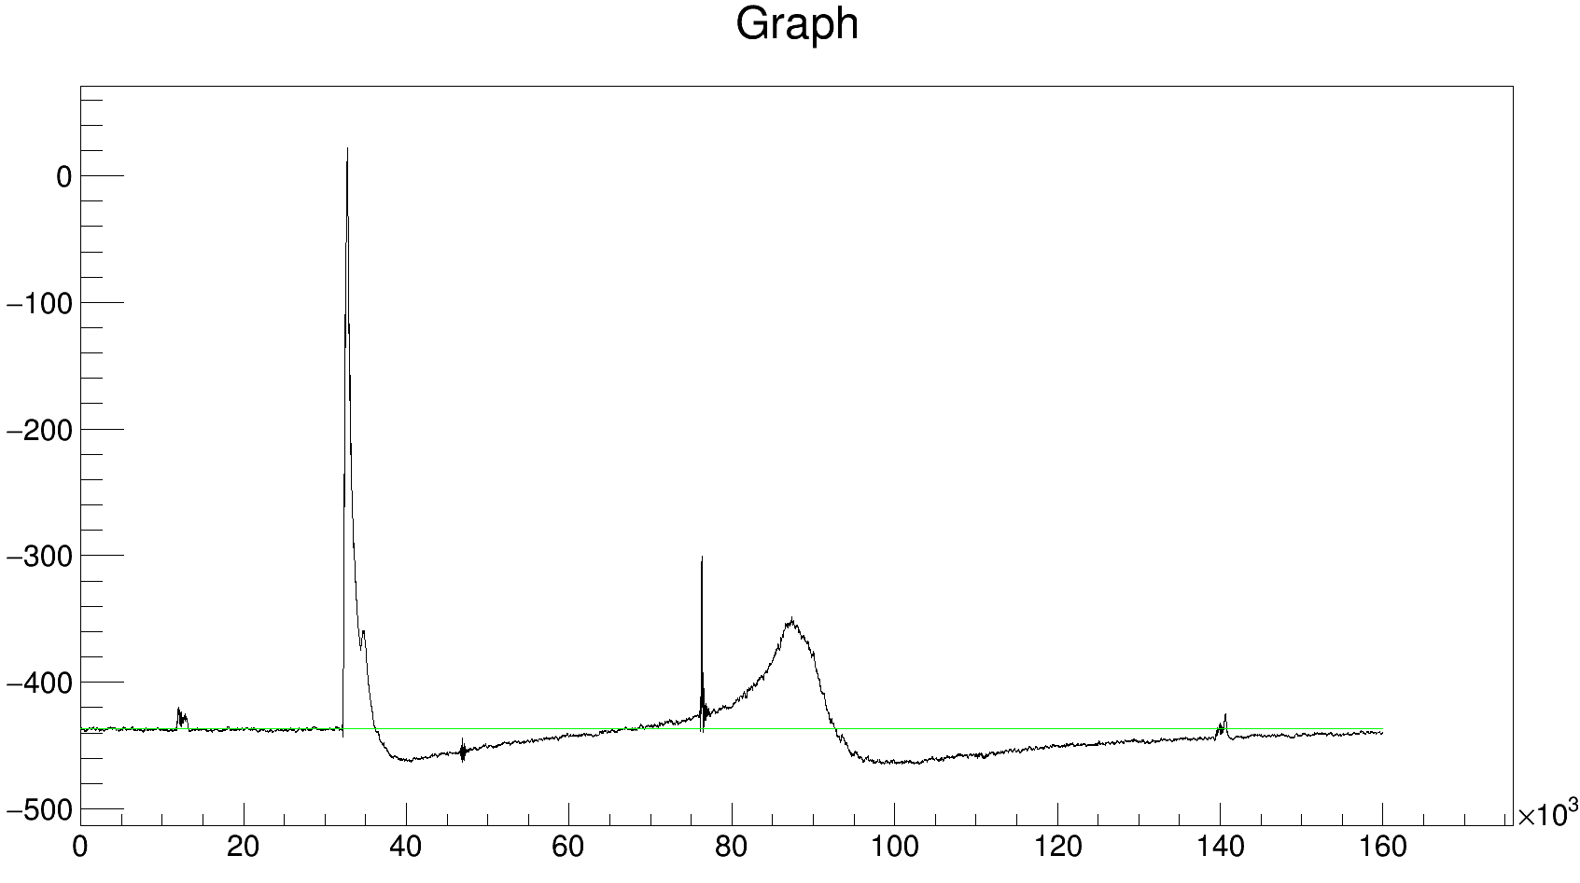
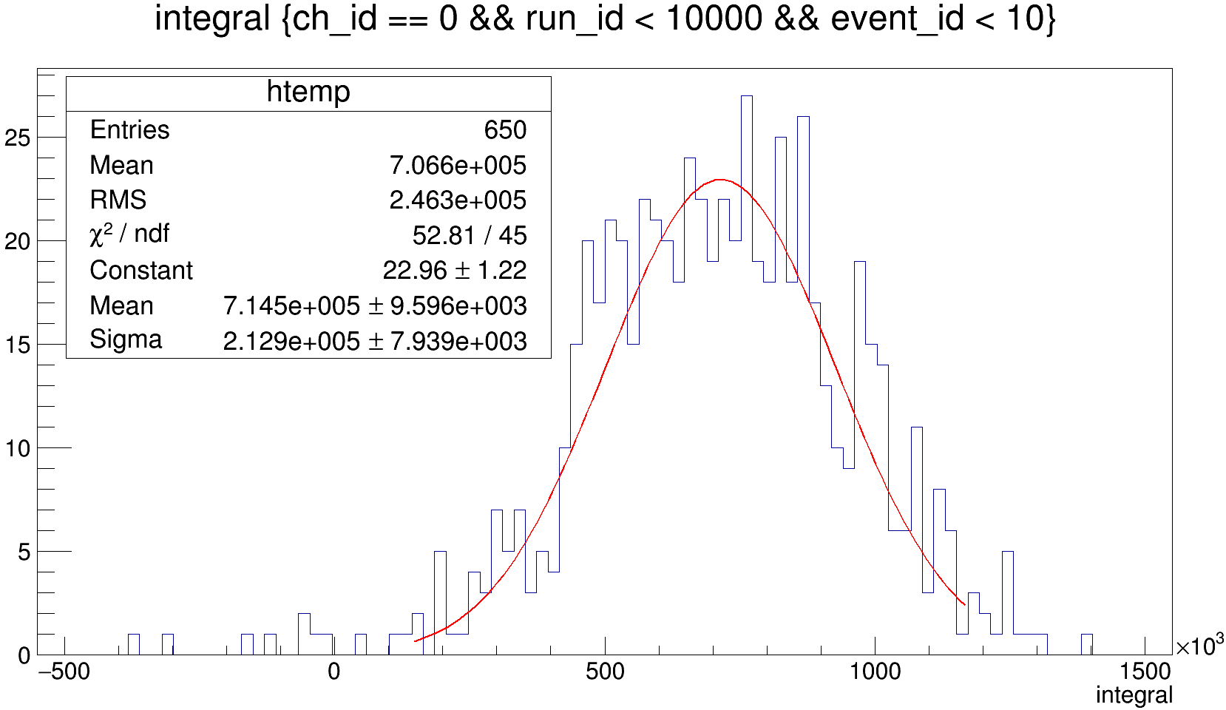
event_x-ray_6_thmV, ∑3PMT
From 68000 to 92700 ns

Slide 19
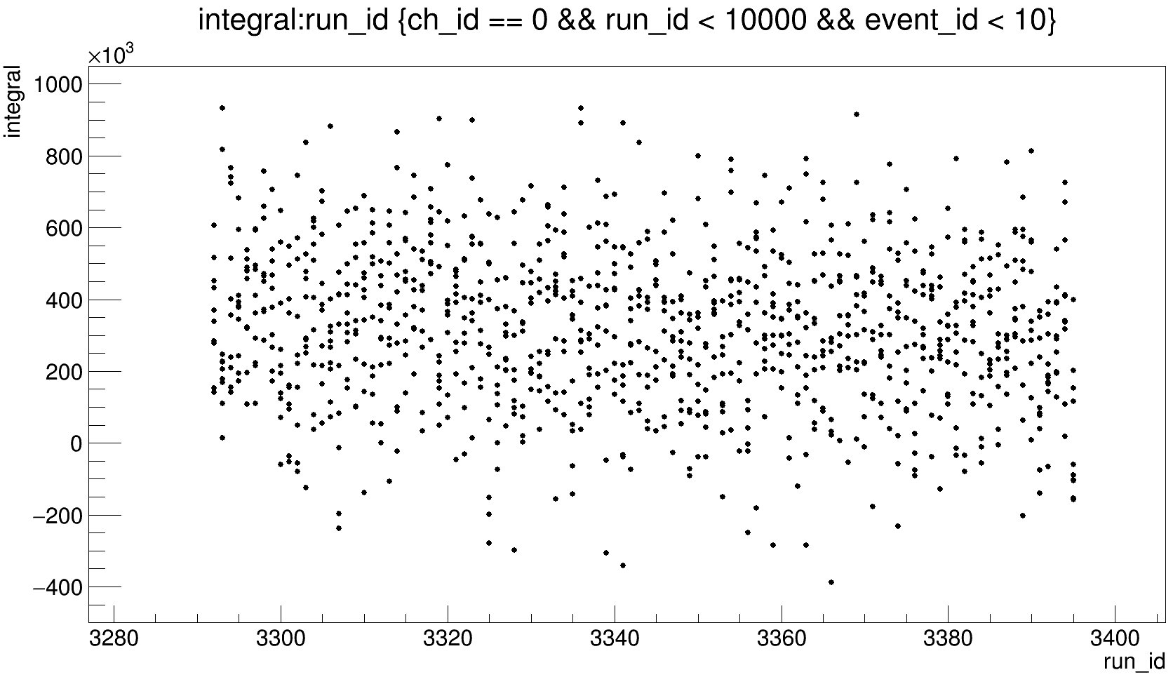
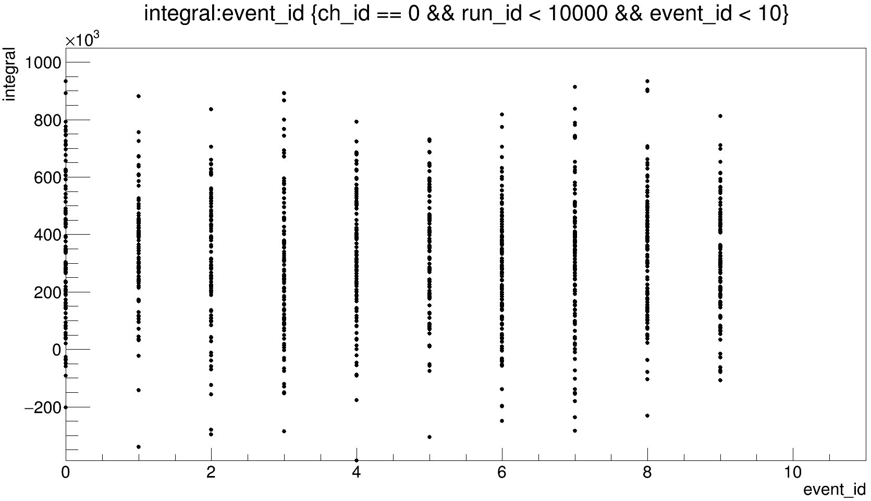
event_x-ray_5_thmV, ∑3PMT

Slide 20
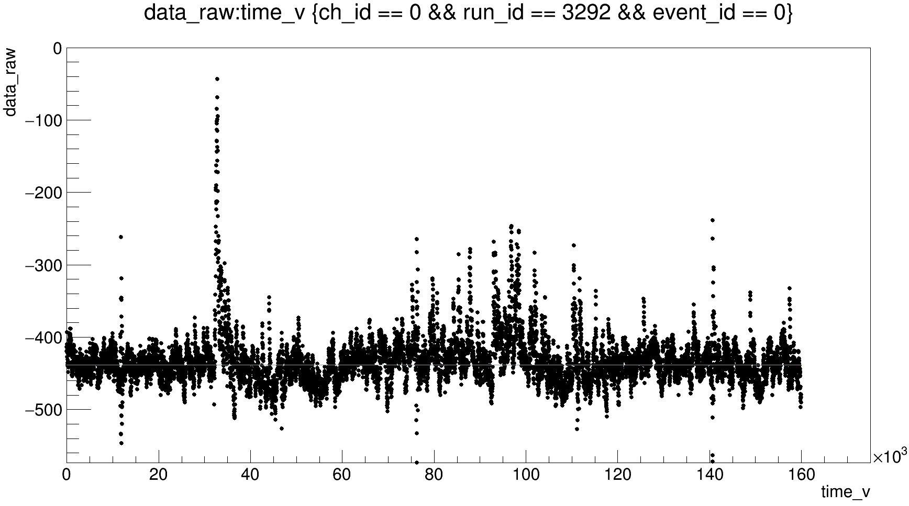
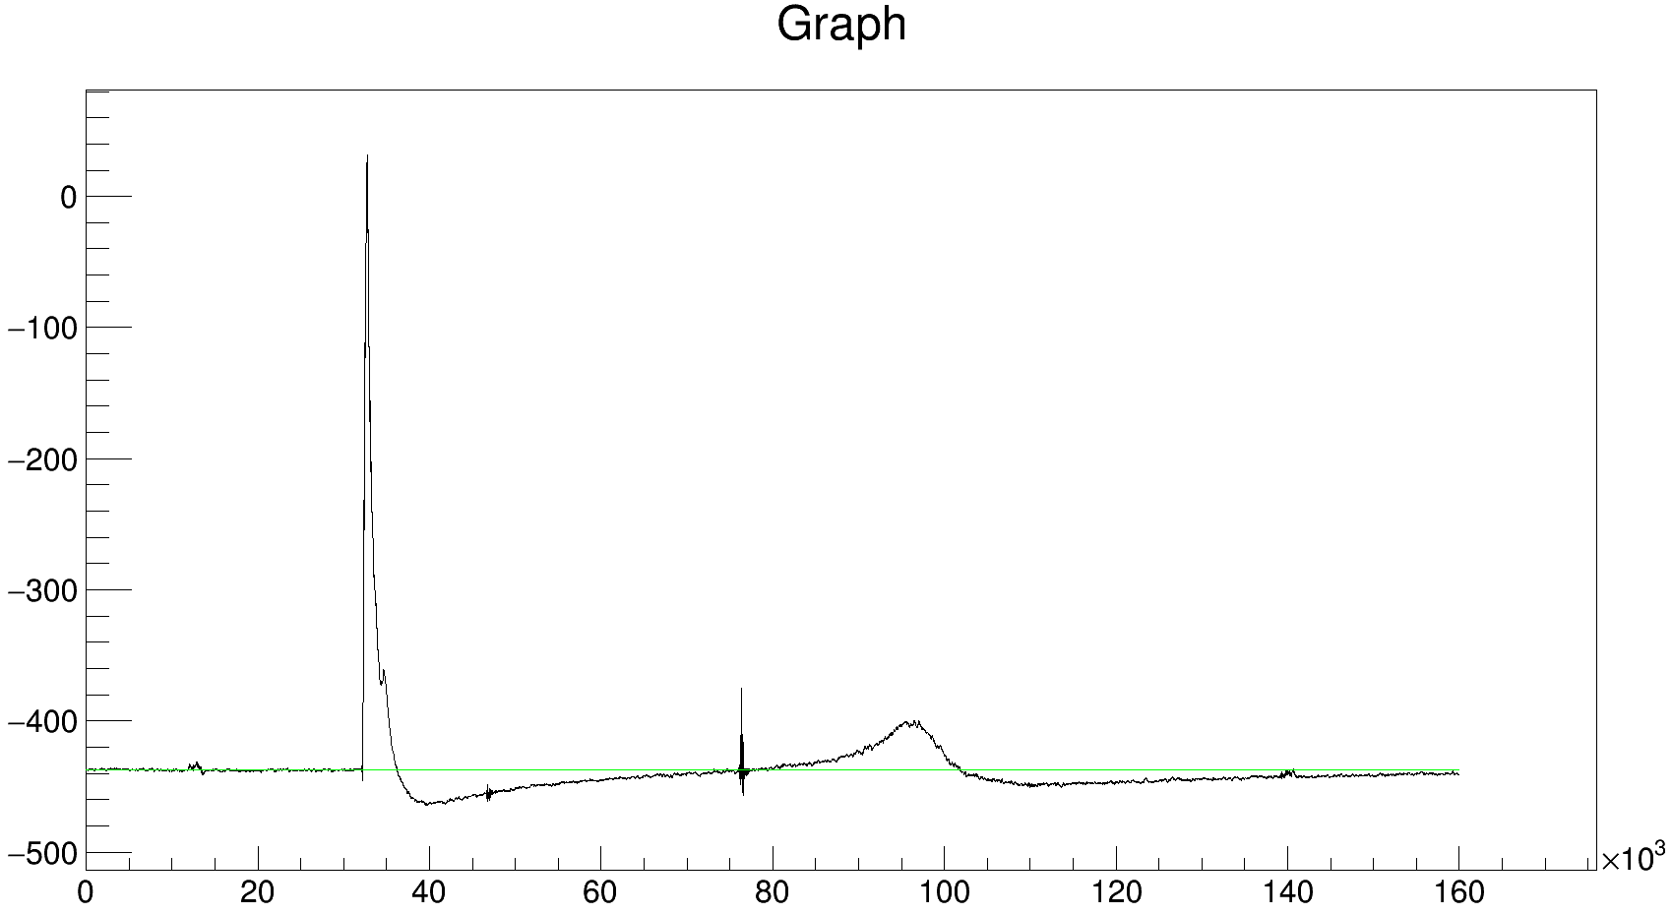

event_x-ray_5_thmV, ∑3PMT
From 78000 to 101834 ns

Slide 21


event_x-ray_4_thmV, ∑3PMT

Slide 22



event_x-ray_4_thmV, ∑3PMT
From 90000 to 119000 ns

Slide 23
1PMT

Slide 24


event_x-ray_20_thmV, 1PMT

Slide 25



event_x-ray_20_thmV, 1PMT
From 43500 to 71030 ns

Slide 26


event_x-ray_18_small_2, 1PMT

Slide 27



event_x-ray_18_small_2, 1PMT
From 46000 to 72560 ns
integral < 2E6

Slide 28


event_x-ray_16_thmV, 1PMT

Slide 29



event_x-ray_16_thmV, 1PMT
From 45000 to 72260 ns

Slide 30


event_x-ray_14_thmV, 1PMT

Slide 31



event_x-ray_14_thmV, 1PMT
From 47400 to 75600 ns

Slide 32


event_x-ray_12_thmV, 1PMT

Slide 33



event_x-ray_12_thmV, 1PMT
From 58000 to 77000 ns
integral > 15000 &&
integral < 300E3

Slide 34


event_x-ray_10_thmV, 1PMT

Slide 35





event_x-ray_10_thmV, 1PMT
From 58000 to 76200 ns
run_id > 2954 && run_id < 3032

Slide 36

event_x-ray_10_thmV, 1PMT
Значительный вклад систематической ошибки:
Откуда начинать интегрировать?
Какие пределы выбирать для фитирования?
Если интегрировать усредненное значение, то при каких условиях отбора?
Ошибка интеграла будет ~30%
From 58000 to 76200 ns
run_id > 2954 && run_id < 3032 &&
integral > 0 && integral < 220E3

Slide 37


event_x-ray_10_thmV_recalib, 1PMT

Slide 38



event_x-ray_10_thmV_recalib, 1PMT
From 46000 to 76200 ns

Slide 39


event_x-ray_9_thmV, 1PMT

Slide 40



event_x-ray_9_thmV, 1PMT
From 49000 to 79000 ns

Slide 41


event_x-ray_8_thmV, 1PMT

Slide 42



event_x-ray_8_thmV, 1PMT
From 48000 to 81830 ns

Slide 43


event_x-ray_7_thmV, 1PMT

Slide 44



event_x-ray_7_thmV, 1PMT
From 55000 to 86100 ns

Slide 45


event_x-ray_6_thmV, 1PMT

Slide 46





event_x-ray_6_thmV, 1PMT
From 60000 to 93000 ns

Slide 47


event_x-ray_5_thmV, 1PMT

Slide 48





event_x-ray_5_thmV, 1PMT
From 80000 to 104400 ns
No cuts
80 bins
60 bins
40 bins

Slide 49


event_x-ray_4_thmV, 1PMT

Slide 50





event_x-ray_4_thmV, 1PMT
From 94000 to 130000 ns
No cuts
100 bins
200 bins
500 bins
Интеграл не определен; < 30 pe

Slide 51
GEM

Slide 52




event_x-ray_20_thmV, GEM
No cuts
67316 ns
37200 ns
Integral < 200E3; 90 events;
Можно было бы понять форму наводки, но не хватает статистики

Slide 53



event_x-ray_18_small_2, GEM
No cuts
68200 ns
37600 ns

Slide 54



event_x-ray_16_thmV, GEM
No cuts
69390 ns
36800 ns

Slide 55



event_x-ray_14_thmV, GEM
No cuts
71605 ns
36700 ns

Slide 56




event_x-ray_12_thmV, GEM
57500 ns
74505 ns
No cuts
36900 ns
From 57500 to 74505 ns
From 36900 to 74505 ns

Slide 57



event_x-ray_10_thmV, GEM
78250 ns
No cuts
37000 ns

Slide 58


event_x-ray_10_thmV_recalib, GEM
78250 ns
No cuts
37000 ns

Slide 59



event_x-ray_9_thmV, GEM
79360 ns
37400 ns

Slide 60





event_x-ray_8_thmV, GEM
83820 ns
37400 ns

Slide 61





event_x-ray_7_thmV, GEM
87560 ns
37400 ns

Slide 62





event_x-ray_6_thmV, GEM
93365 ns
37450 ns

Slide 63




event_x-ray_5_thmV, GEM
103500 ns
37500 ns

Slide 64



event_x-ray_4_thmV, GEM
103500 ns
37800 ns

Slide 65
SiPM; X-ray

Slide 66
3PMT; Cd

